Slide 1
Tax Notice Review
By: Jim Kohl, CPP

Slide 2
Jim Kohl, CPP
Payroll career started in 2006
Paychex, Inc (9 years)
Namely, Inc (4 years)
Currently building out a new form of payroll:
Check Technologies, Inc. (1 year)
CPP in 2018. MBA 2020. Multiple presentations for APA, and HR conferences. Published payroll articles.

Slide 3
Disclaimer: There are many reasons a tax agency will send a notice to an individual or company. For purposes of this presentation we will be focusing on notices to companies (Employers) who receive notices for income and employment tax reasons.

Slide 4
Content
What are Tax Notices?
What causes a Tax Notice?
First Assessment
Power of Attorney
Abatement
Resolution
Questions

Slide 5
What are Tax Notices?

Slide 6
Defined
A tax notice is a letter (or online notification) from a tax agency.
The notice is used to alert a taxpayer about an issue with the following:
Account
(Including informational changes)
Payment
(Underpaid/Overpaid)
Tax return
(Filed late, not filed, more information needed)

Slide 7
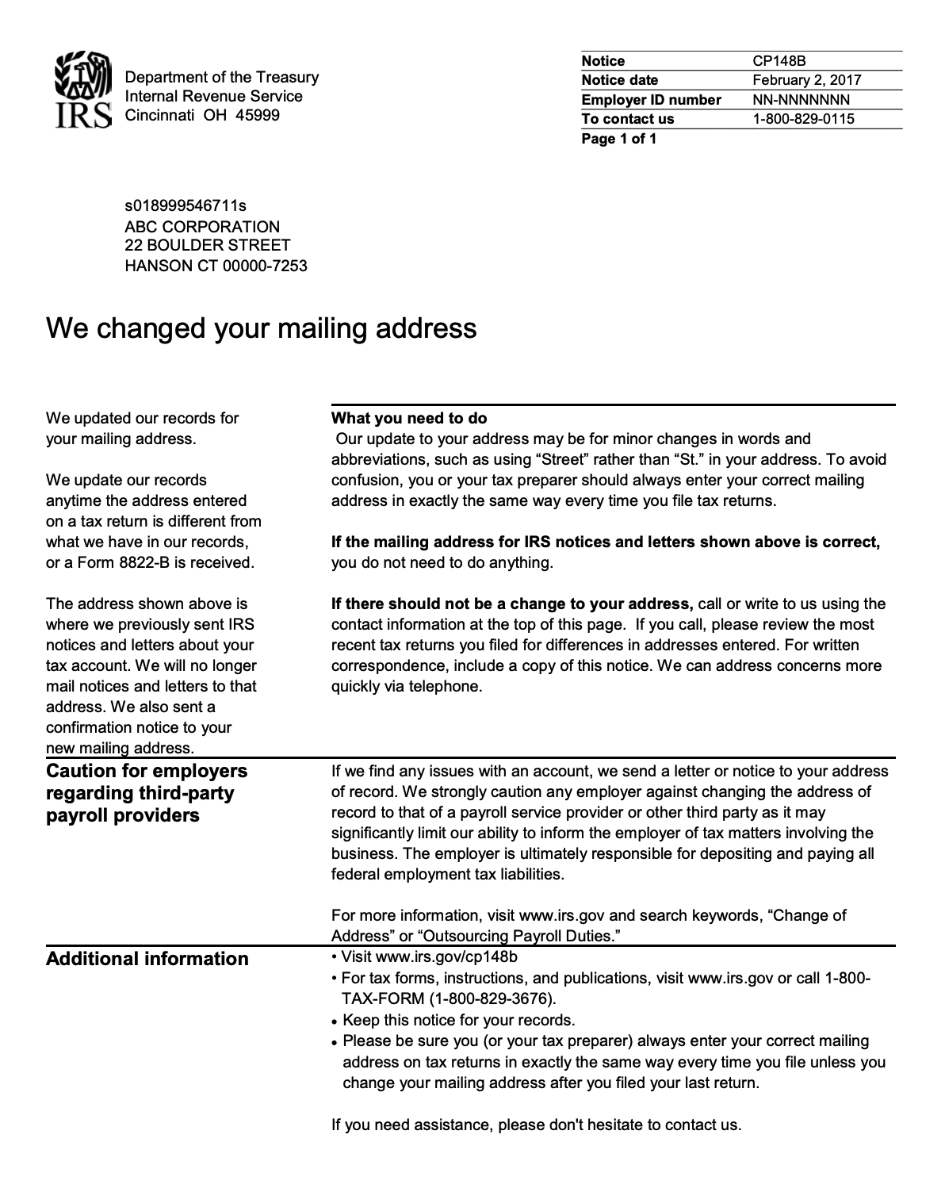
Account Changes
The IRS may send you a letter confirming that they have updated your address based on recent filings.
This may be a simple change like “ST” for “Street”, or an update to the last known address on file.
Informational account changes while not containing a monetary impact, should still be responded to as needed.

Slide 8
Payment/Refund
If you have a balance on your tax account, you’ll get a notice letting you know:
How much you owe
When it’s due
How to pay
If you have an overpayment on your tax account, you’ll get a notice letting you know:
Refund amount
Period it is from
When they will refund

Slide 9
Tax Return
Missing?
Agencies will reach out if you have established a relationship and then a return is not filed.
These may come with assessments
(i.e. your previous filings were for X, we determine you owe Y.)
Late?
Agencies may reach out and acknowledge a late filing with no penalty as a courtesy.
Agencies will let you know if your filing was late.
Even if you use a 3rd party to file, the agency will reach out and could penalize for late filings.

Slide 10
Not all Notices are Bad
You heard me correctly… Not all notices are BAD
Notices will sometimes contain Important information:
Rates
Filing forms*
New State Info
New online service,
PIN number
Sometimes they will send you a notice letting you know you checked into the site.
*Monthly filer notice could be a proactive heads up to fix your frequency.

Slide 11
What causes a Tax Notice?

Slide 12
Cause?
A tax notice can be sent for many reasons. The information typically revolves around:
A correction on a return
A balance due
Overpayment
Timing
There is often a simple solution to an issue indicated in a tax notice.

Slide 13
Correction on a Return
There are various reasons for a return to be corrected and an agency to notify you of a change.
Most often a notice of this nature will include:
Problem the agency found
Changes they made
Action you need to take

Slide 14
Balance Due
The worst kind of notice?
A balance due may indicate:
Tax filed but unpaid
Assessment amount
Penalty & Interest

Slide 15
Overpayment
False safety…
An overpayment notice can be a record of an overpayment amount recorded on the quarterly return.
An overpayment notice can also be the start of something much bigger…

Slide 16
Timing
Sometimes you’re ahead of the game!
You may have already addressed an issue, amended a return, remitted additional funds, etc.
Tax agencies are notoriously late or behind the curve. Some notices are just sent because they are automatically generated.

Slide 17
First Assessment

Slide 18
Information
Each notice or letter contains A LOT of valuable information.
It is important that you read it carefully!
Confirming this information up front can not only save time.
It can also help to spot a scam notice as well.

Slide 19
Information
Notice type
Contact Information
Page Count
Period in question
Taxpayer ID
Tax Year
Notice Date

Slide 20
Step by Step
Step 1: Confirm the ID in question. Whether it is for a company (or an individual), confirming the ID can prevent a lot of downstream headache.
Step 2: Check for time period - When is a response (or payment) due?
Step 3: Send notice to the “RIGHT” payroll provider to save P&I
Step 4: Scan notice and save all notices

Slide 21
Contact
What if you want to talk to someone about the notice?
Notices include contact information:
Phone number on notice
General agency toll-free numbers
Department specific numbers
If a specific agent/employee is working the case
The notice will show a specific phone number to reach that employee or the department manager.

Slide 22
Power of Attorney

Slide 23
Power of Attorney
A power of attorney (POA) is a legal document giving one person (Third Party) the power to act for another person or entity.
Things to note:
Nothing lasts forever… some expire
Can delay resolution… will take time to go on file

Slide 24
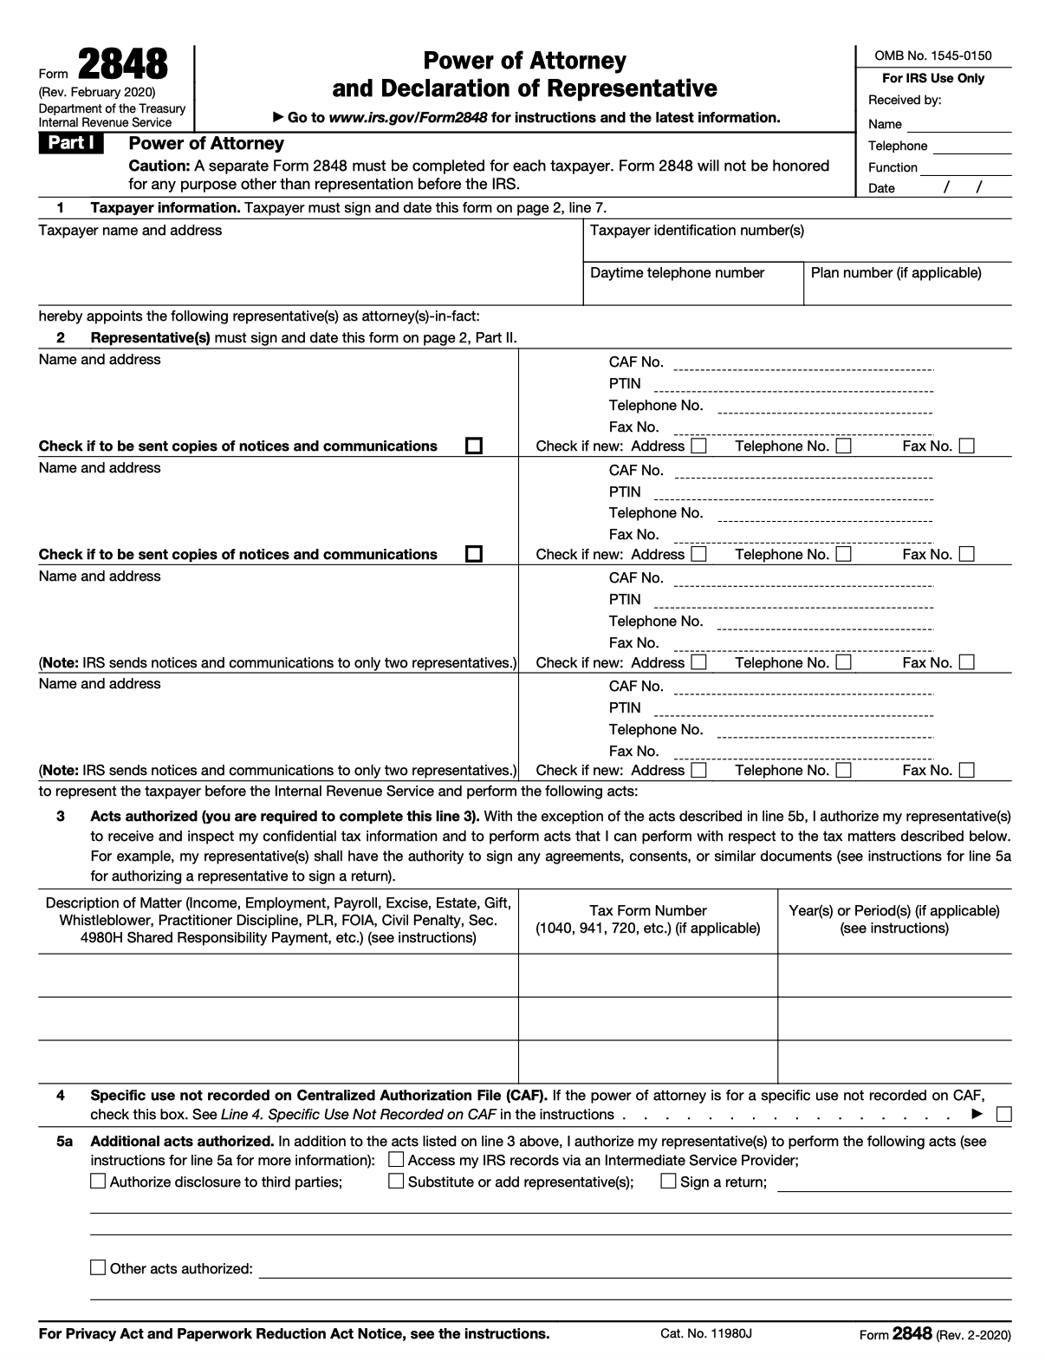
IRS uses Form 2848
Ability to:
Sign
Communicate
File
Review
Also State POA’s:
IL-2848 (Illinois)
N-848 (Hawaii)
RD-1061 (Georgia)

Slide 25
Abatement

Slide 26
Contacting the Agency
Write down number you are calling
If you are transferred ask for new number/extension of transfer
Write down day and time of call
And any subsequent calls
Write down agent ID and Name
If transferred write down each consecutive person
When possible, ask for:
Direct line
Direct Email Address
Confirmations of all correspondence
Keep organized
Folder per notice (or agency)
Never give up!

Slide 27
Reasonable Cause
If you have a legitimate reason for not being able to file or pay taxes on time, you can request an abatement of the amount owed. Reasonable causes:
Natural disasters or similar hazards
Inability to obtain relevant tax records
Death or Illness of the parties involved
These are not the only reasons. The agency may also consider any other reason that shows you tried in good faith to meet the tax obligations but could not.
Whatever the reason, you may have to prove it, evidence can help.

Slide 28
IRS First-Time Penalty Abatement
The first-time penalty abatement (FTA) waiver is an administrative waiver that the IRS may grant to relieve taxpayers from failure-to-file, failure-to-pay and failure-to-deposit penalties if certain criteria are met.
The policy behind this procedure is to reward taxpayers for having a clean compliance history; everyone is entitled to one mistake.
Individuals and businesses may request FTA for any failure-to-file, failure-to-pay or failure-to-deposit penalty.

Slide 29
Resolution

Slide 30
Resolution
Resolutions may vary
Some notices can be resolved in minutes.
Some notice can take months.
Some might not happen…
Responding to the agency before the deadline can help you avoid tax penalties and interest.

Slide 31
Another NOTICE?!
Remember!
Some informational notices might be about account changes…
One of those changes can be your abatement, correction or confirmation that your account is in balance.

Slide 32
COVID Impact
What changes has this year seen?
Employees - Not in office. On leave. Rehired. Let go.
Taxes - Some remitted. Late options to file. Delayed payments.
Agencies - Also not in office. Late on reconciling. Backed up!
There are already reports on notices that shouldn’t have gone out. Stay diligent!

Slide 33
Questions?

Slide 34
Thank you!
Than
LinkedIn: Jim Kohl, CPP
Twitter: @TheJimKohl

