Slide 1
Introduction to Abandoned and Unclaimed Property
09/16/20

Slide 2
MEET YOUR PRESENTERS
Sonja Roman-Molina
Kulsoom Kamruddin
Director
Abandoned and Unclaimed Property
Ft. Lauderdale, Florida Sonja.Roman@ryan.com 954.740.6240 Ext. 27-2033 570.350.2722 Mobile
Manager
Abandoned and Unclaimed Property
Dallas, Texas
Kulsoom.Kamruddin@ryan.com 972.934.0022 Ext. 10-1274 817.655.4716 Mobile

Slide 3
POLLING QUESTION
How familiar are you with Unclaimed Property
Very Familiar - It is included as part of my job responsibilities
Some Idea – I know what unclaimed property is but never worked on it closely
Not Familiar – I have never heard of unclaimed property

Slide 4
$260 MILLON
of Unclaimed Funds Returned by New York so far in 2020!

Slide 5
AGENDA
Abandoned and Unclaimed Property (“AUP”)101
Third Party Administrators
Holder Obligations
Risks of Non-Compliance
Internal Considerations
Resources

Slide 6
AUP 101 HISTORY
Origins in British Common Law
Escheat versus custodial
Uniform Unclaimed Property Acts
1955, 1966, 1981, 1995, 2016
54 U.S. Reporting Jurisdictions
50 states, Washington D.C., Guam, Puerto Rico, U.S. Virgin Islands

Slide 7
AUP 101 DIFFERENCES IN LAW
The challenge with complying: little uniformity among state unclaimed property laws
Dormancy periods
Filing deadlines
Filing methods
Industry classifications
Payment methods
And the laws are constantly changing!

Slide 8
AUP 101 MISCONCEPTIONS
Unclaimed property is NOT a tax - it is a Consumer Protection Law
Nexus does not apply
States’ rights are derivative
Administrative appeals are rare
No statute of limitations

Slide 9
AUP 101 summary OF LAWS
PURPOSE
BENEFITS
Consumer Protection
CONSEQUENCES
Relieve Holder Expense
Economic Windfall to Benefit the Public
More Robust Controls in Place Similar to Sarbanes-Oxley (“SOX”)
Good Customer Relations
Books and Records Organized
Revenue Generation - As of 2016, over $40 billion was being held at the states’ offices
Time, Money and Effort of Holders to Achieve Compliance

Slide 10
AUP 101 COMMON PROPERTY TYPES
There are over 100 property type codes established by NAUPA.
Intangible Property
Uncashed checks
Credit balances
Gift cards/certificates
Insurance proceeds
Equity related property
Layaways
Tangible Property
Safe deposit boxes
Collectibles
Jewelry
Precious metals
Other monies

Slide 11
COMMON AREAS PAYROLL PROPERTY TYPES
Common areas of unclaimed property related to payroll are:
Uncashed payroll checks
Commissions
Garnishments
Expense checks
Benefit checks (e.g., FSA checks)

Slide 12
POLLING QUESTION
Does your company use a Third Party Administrator (TPA) for payroll processing?
YES
NO

Slide 13
THIRD PARTY ADMINISTRATORS (TPA)
Review contract – consult with legal counsel
Determine who holds obligation
Fulfill unclaimed property compliance requirements
Obtain data from TPA to comply with unclaimed property rules
If TPA is responsible to comply with unclaimed property rules, ensure they do what they are contracted to do (e.g., due diligence and reporting)
Obtain copies of unclaimed property reports from the TPA if they are responsible for filing
Under audit, it will be the company’s responsibility to prove it is compliant

Slide 14
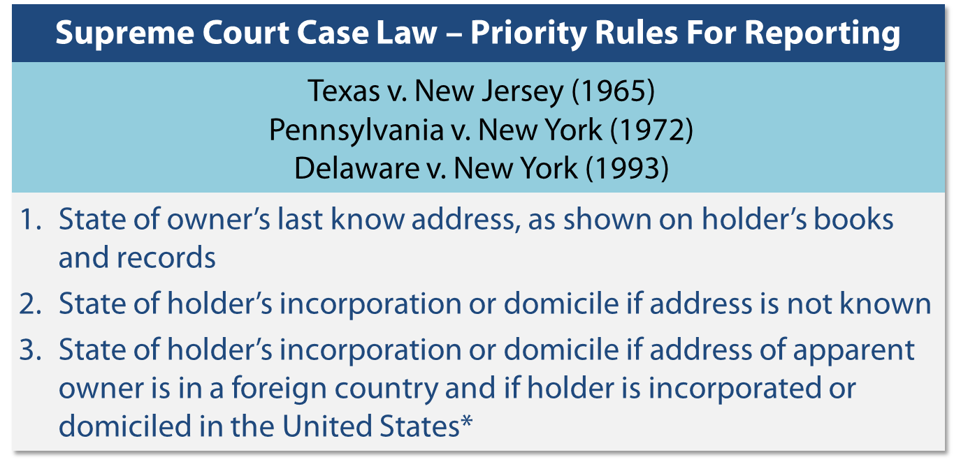
HOLDER OBLIGATIONS REPORTING REQUIREMENTS
Where to Report?
Rules of jurisdiction were established in the court case Texas v. New Jersey (65)

Slide 15
HOLDER OBLIGATIONS REPORTING REQUIREMENTS
When to Report?
Typically annual reporting requirements – there are exceptions
How to Report?
Depending on the due date for the report, the cut-off date to use can be in March, June or December.
Reporting methods
Payment methods

Slide 16
HOLDER OBLIGATIONS REPORTING REQUIREMENTS
Dormancy and Cut-Off Dates
Property type - Dormancy ranges from 1 year to as long as 15 years
Company classification
Spring, summer and fall states

Slide 17
HOLDER OBLIGATIONS STATUTORY DUE DILIGENCE
Minimum degree of effort required by law
Strict requirements to follow
Consider the following regarding mailing
Method
Timing
Content
Minimum threshold
Misc. requirements

Slide 18
RISKS OF NON-COMPLIANCE PENALTIES & INTEREST
Penalties
Generally a daily fixed fee capped at a threshold
Interest
Generally applied at 5% - 25% of property value and capped at a threshold
Penalties and interest may be assessed if holders:
Fail to report timely
Fail to remit timely
Fail to comply with the Statute
Submit a fraudulent report

Slide 19
RISKS OF NON-COMPLIANCE AUDIT
Audit targets include:
Holders not filing unclaimed property reports
Holders filing unclaimed property reports, but underreporting
Holders filing unclaimed property reports with errors
Audit triggers include:
Recent M&A activity
Major publicity
Company size
Industry

Slide 20
RISKS OF NON-COMPLIANCE AUDIT
TYPICAL AUDIT PHASES
Phase I – Scoping
Corporate information gathering
Entity selection and property type scoping
Phase IV – Settlement
Closing or settlement of the examination
Record gathering and verification
Phase II – Data Gathering
Quantification of amounts due
Phase III – Research
Population scheduling
Research, remediation, and due diligence
Review

Slide 21
RISKS OF NON-COMPLIANCE OTHER
Other considerations
Aggressive scheduling criteria
Estimation and extrapolation
Reputation
Constantly changing environment

Slide 22
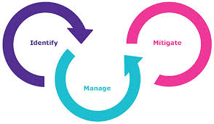
INTERNAL CONSIDERATIONS RISK ASSESSMENT
Consider performing an internal risk assessment – there are various benefits
Quantify potential exposure
Determine risk mitigation techniques, e.g., research and remediation, voluntary compliance
Achieve unclaimed property compliance

Slide 23
INTERNAL CONSIDERATIONS RISK ASSESSMENT
Steps to consider when performing internal risk assessment
Obtain organizational structure
Understand the business
Review compliance history
State scheduling criteria
Supporting documentation

Slide 24
INTERNAL CONSIDERATIONS AMNESTY/VDA
Benefits of voluntary compliance
Reduced look back periods
Audit risk mitigated
Elimination/reduction of penalties and interest
Holder controls review of records
Reduces time and money spent on auditor requests

Slide 25
INTERNAL CONSIDERATIONS EXEMPTIONS
Property type
Transaction type
Amount threshold
Deferrals

Slide 26
INTERNAL CONSIDERATIONS ASSET RECOVERY
Often overlooked
State and local municipalities
Confirm you are in compliance beforehand
Claim funds that belong to your company
Increase your cash flow

Slide 27
INTERNAL CONSIDERATIONS BEST PRACTICES
Comprehensive policies and procedures
Meet on an annual basis
Capturing new areas of Unclaimed Property
Software
Outsourcing / Co-sourcing
Strengthening your record retention
Educate employees
UPPO

Slide 28
RESOURCES
Helpful Websites
www.uppo.org
www.missingmoney.org
www.unclaimed.org
www.uniformlaws.org
www.bna.com
www.ryan.com/Abandoned-and-Unclaimed-Property.aspx

Slide 30
Questions?

