Slide 1
What to Expect When Your Employee is Expecting: Family and Medical Leave Act (FMLA) and the PUMP Act
dol.gov/agencies/whd
1-866-4-US-WAGE

Slide 2
Overview
Prohibited Retaliation
1
During an employee’s pregnancy
4
2
Employee leave for birth, adoption, or foster care placement
5
Compliance Assistance
3
Employee return to work and breaks to pump
6
Questions and Answers

Slide 3
During An Employee’s Pregnancy

Slide 4
During Pregnancy
Birth & Bonding
Return to Work
What rights do pregnant employees have to take leave from work?
The Family and Medical Leave Act (FMLA) is a federal law that provides job-protected leave to certain workers.
A worker who is eligible may take FMLA leave for their own or a covered family member’s pregnancy.
Fact Sheet #28: The Family and Medical Leave Act

Slide 5
During Pregnancy
Birth & Bonding
Return to Work
Employee Benefits and Protections under FMLA
Up to 12 workweeks of leave each leave year for family and medical reasons
Up to 26 workweeks of leave in a single leave year to care for a covered military member with a serious injury or illness
Continuation of group health benefits under the same conditions as if the employee did not use leave
Return to work at the same or virtually identical job at the end of the leave period
Protection from interference and retaliation

Slide 6
Birth & Bonding

Slide 7
During Pregnancy
Birth & Bonding
Return to Work
An employee has a new child. What rights do they have to take leave from work?
An employee may use FMLA leave when their child is born or placed with them for adoption or foster care, and to bond with their new child.
FMLA leave for birth, placement, or bonding must be taken within one year of the child’s birth or placement.
An employee may also use FMLA leave before the actual placement or adoption of their child in situations where they may be required to, for example:
Attend counseling sessions,
Appear in court,
Consult with the attorney or doctor(s) representing the birth parent,
Submit to a physical examination, or
Travel to another country to complete an adoption.

Slide 8
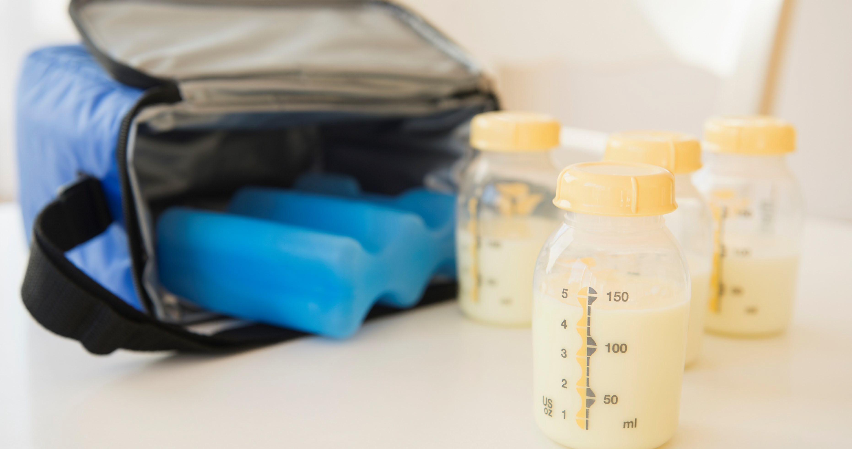
Return to Work & Nursing

Slide 9
During Pregnancy
Birth & Bonding
Return to Work
What happens when an employee is ready to go back to work?
Under the FMLA, when an employee goes back to work, you must restore them to the same job that they held when their leave began, or to a job that is virtually identical to their original job in terms of pay, benefits, and other employment terms and conditions (including shift and location).

Slide 10
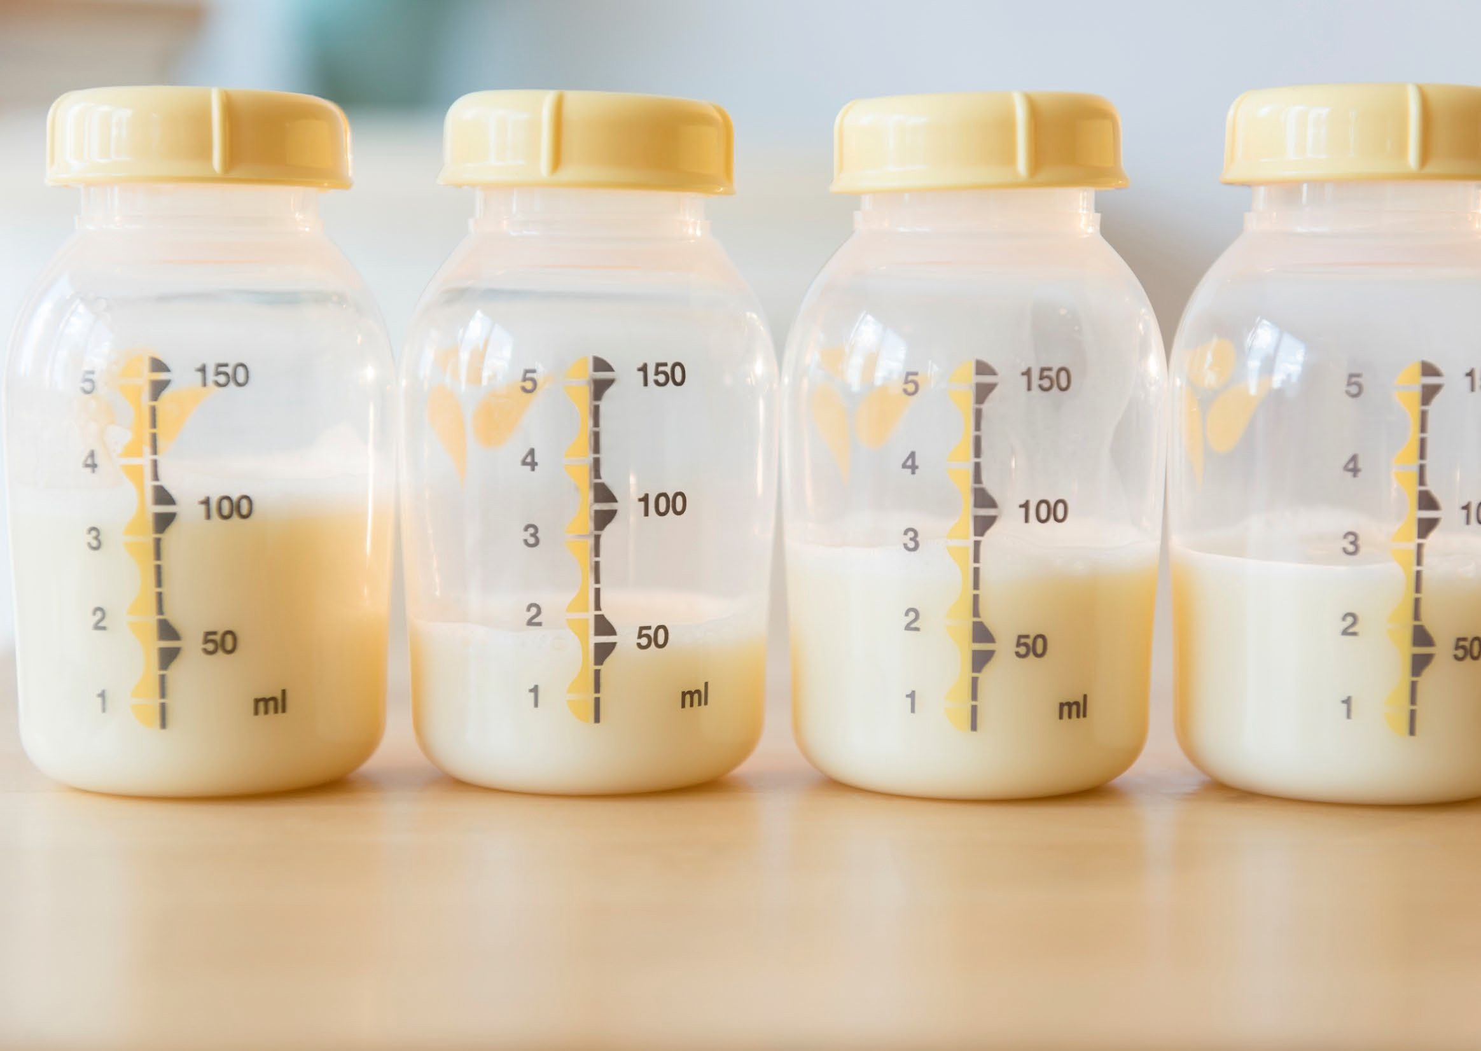
FLSA Pump at Work Protections
The Fair Labor Standards Act (FLSA) requires employers to provide reasonable break time and a private place other than a bathroom for an employee to pump breast milk for their nursing child for one year after the child's birth each time such employee has need to pump at work.

Slide 11
The PUMP Act
On December 29, 2022, the Providing Urgent Maternal Protections for Nursing Mothers Act (PUMP for Nursing Mothers Act or PUMP Act) became law, extending right to pump protections to millions of workers and allowing for additional remedies for violations.
Extended coverage effective as of December 29, 2022.
Additional remedies available for violations occurring on or after April 28, 2023.

Slide 12
Eligible Employees
Nearly all employees covered by the FLSA are eligible to pump at work.
Employees are eligible to pump at work for one year after their child’s birth.
Narrow exemptions may apply for certain employees of small companies and certain transportation employees.

Slide 13
Enterprise Coverage
All employees of an enterprise are covered under the FLSA if the employer is:
Engaged in interstate commerce, has at least two employees, and does at least $500,000 a year in business, or
Engaged in the operation of a hospital, residential medical or nursing care facilities, schools, preschools, or a public agency.

Slide 14
Individual Coverage
Individual employees may be covered and entitled to FLSA protections to pump at work if they are engaged in interstate commerce even if the employer is not a covered enterprise.
Interstate commerce includes making out-of-state phone calls, receiving or sending interstate mail or electronic communications, ordering
or receiving goods from out-of-state suppliers, handling credit card transactions, and performing accounting or bookkeeping for such activities.
Domestic service workers, such as housekeepers, full-time babysitters, and cooks, are normally covered by the law.

Slide 15
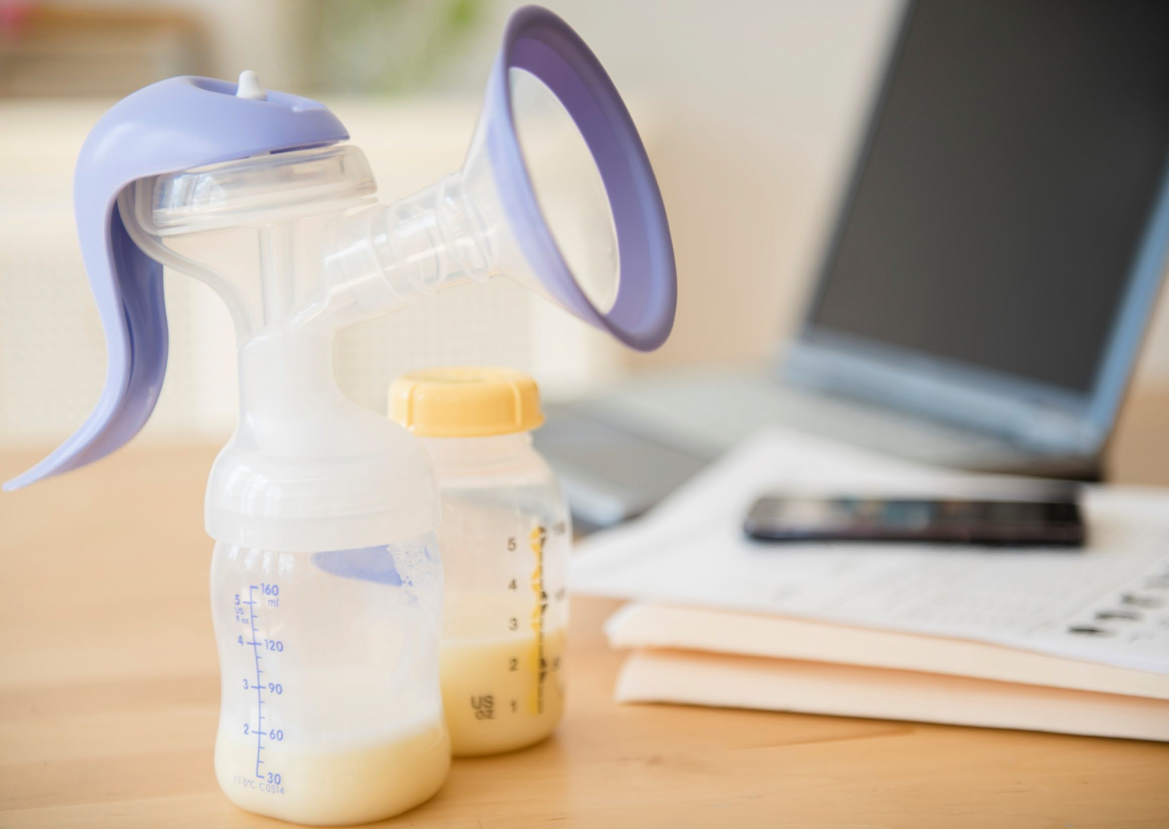
Reasonable Break Time
The FLSA requires employers to provide nursing employees:
Reasonable break time
Each time such employee has need to pump at work
For one year after the child’s birth
The frequency of breaks needed to pump at work, as well as the duration of each break, will likely vary.

Slide 16
Reasonable Break Time - Examples
Irina, a shift manager at a fast-food restaurant, takes four 25-minute pump breaks each day when she first returns to work after the birth of her child.
Leslie, a department store delivery driver with a nine-month- old baby, needs two 30-minute pump breaks each day she works.

Slide 17
Compensation for Break Time
As with other breaks under the FLSA, the nursing employee must be completely relieved from duty or the time spent pumping must be counted as hours worked for the purposes of minimum wage and overtime requirements.
If an employer already provides paid break time and if an employee chooses to use that time to pump, they must be compensated in the same way that other employees are compensated for break time.
An employer must also pay for pump breaks if required by Federal or State law or municipal ordinance.

Slide 18
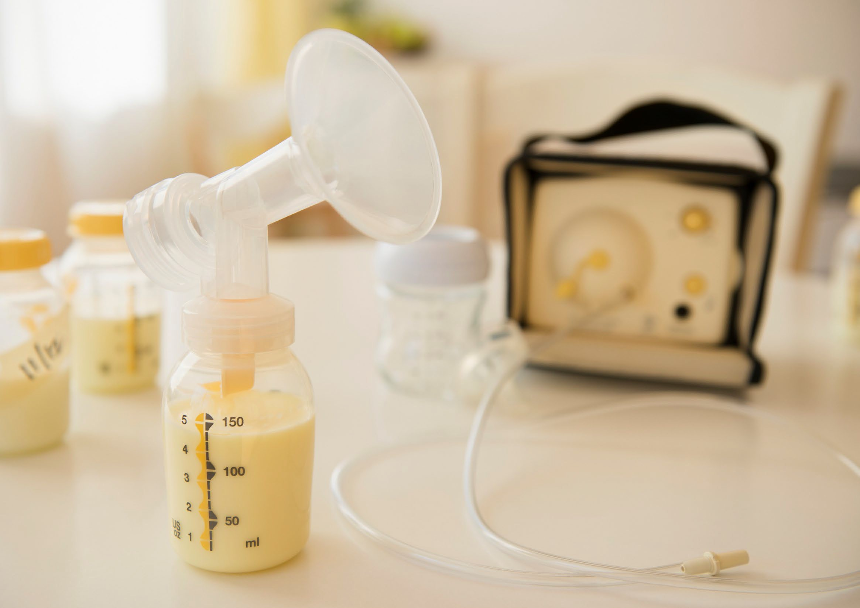
Space Requirements
Nursing employees must be provided a space that is:
Shielded from view,
Free from intrusion from coworkers and the public, and
May be used to pump breast milk.
The space cannot be a bathroom.
Poll Question #1

Slide 19
Shielded from View / Free from Intrusion
Employers must ensure the employee’s privacy, for example, by displaying a sign when the space is in use or providing a lock on the door.
Workers who telework must also be free from observation by any employer-provided or required video system, including computer camera, security camera, or web conferencing platform.
Employees on passenger trains may temporarily obscure the view of recording devices when the train is not moving.

Slide 20
Functional Space
The location must be functional as a space for pumping milk.
An employer may temporarily designate a space or make a space available when needed by the employee.
Employers should take into consideration the number of nursing employees and their work schedules to determine whether more than one space should be designated or created.

Slide 21
Space - Example
Merin, a logging company employee, pumps in a break room at the company’s office. The room is shielded from view and Merin is permitted to lock the door during pump breaks.
Poll Question #2

Slide 22
Undue Hardship Exemption
An employer that employs fewer than 50 employees is not required to provide break time and space only if it would impose undue hardship.
The employer must demonstrate that compliance requires significant difficulty or expense when considered in relation to the size, financial resources, nature, or structure of the employer’s business.
Not available to employers with 50 or more employees.
All employees who work for the employer, regardless of work site, are counted.

Slide 23
Exemption for Crewmembers of Air Carriers
The FLSA’s pump at work protections do not apply to crewmembers of air carriers.
Crewmember means a person assigned to perform duty in an aircraft during flight time.

Slide 24
Rail Carriers and Motorcoaches
The FLSA’s pump at work protections generally apply to employees of rail carriers or motorcoach services operators as of December 29, 2022. However, coverage for certain employees of rail carriers and motorcoach services operators begins December 29, 2025. These employees include:
Train crew members involved in the movement of a locomotive or rolling stock or who maintain the right of way of a rail carrier, and
Employees involved in the movement of a motorcoach.

Slide 25
Exemptions After Three-Year Delay
Even once pump at work protections are applicable to these employees on December 29, 2025, an exception to these protections may apply if an employer demonstrate that compliance requires significant expense or results in unsafe conditions.
Significant expense does not include installing a curtain or other screening protection.

Slide 26
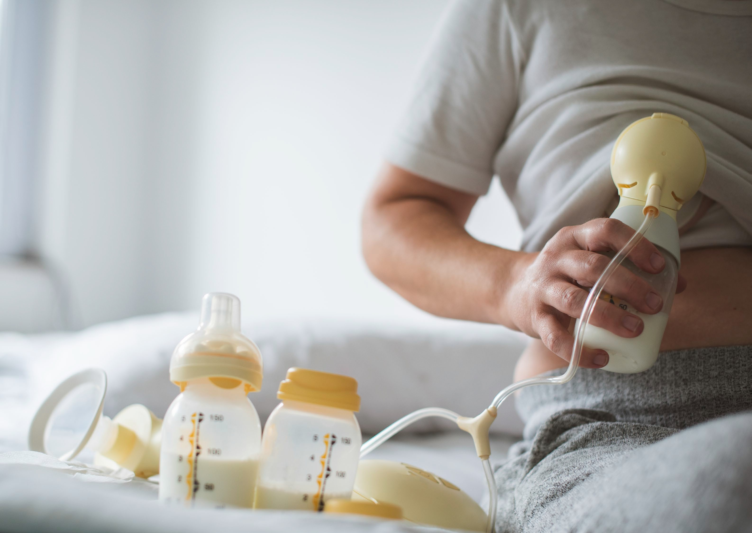
Interaction with State Laws
The FLSA’s pump at work protections do not preempt a State law or municipal ordinance that provides greater protections to employees than those provided by the FLSA.
Many states have laws related to pumping milk at work.

Slide 27
Prohibited Retaliation
It is also a violation of the FLSA to “discharge or in any other manner discriminate against” any employee because, for instance, they filed a complaint to assert their pump at work rights or cooperated in an investigation regarding these protections.
Employees are protected regardless of whether the complaint is made orally or in writing.
Most courts have ruled that internal complaints to an employer are also protected under the FLSA's prohibition on retaliation.

Slide 28
Example – Prohibited Retaliation
Leslie is a delivery truck driver for a department store and takes breaks to pump breast milk twice a day. The supervisor complains that the breaks are interfering with the delivery schedule and moves Leslie to a lower-paying job as a result.
In this example, Leslie has experienced unlawful retaliation under the FLSA.

Slide 29
Remedies
Employers are liable for appropriate legal or equitable remedies under the FLSA.
Effective April 28, 2023, remedies for violations of the reasonable break time and space requirements may include employment, reinstatement, promotion, and the payment of wages lost and an equal amount as liquidated damages, compensatory damages, and make-whole relief, such as economic losses that resulted from violations, and punitive damages where appropriate.
These legal and equitable remedies are already available for violations of the anti-retaliation prohibition.

Slide 30
Enforcement
An employee may file a complaint with WHD or may file a private cause of action seeking appropriate remedies.
An employee or other party can file a complaint with WHD at any time within a two-year statute of limitations.
Special notification procedures may apply to filing a private action where an employer has failed to provide an employee with an appropriate space to pump.
These special procedures do not apply before an employer or other party can file a complaint with WHD.

Slide 31
Special Notification Procedures
Before an employee can file a private suit regarding an employer’s failure to provide a space to pump, the employee must notify the employer of the failure and allow 10 days for the employer to come into compliance.
The employee is not required to provide this notice:
If the worker has been fired for requesting reasonable break time or space,
If the worker has been fired for opposing employer conduct related to PUMP Act rights, or
Where the employer has expressed a refusal to comply.

Slide 32
During Pregnancy
Birth & Bonding
Return to Work
What should employers tell employees so they know they may take breaks to pump?
Post the WHD Break Time for Nursing Mothers poster in English and Spanish
Train supervisors and managers so they are familiar with the requirements of the law
Talk to employees in advance, if possible, about their needs for break time and space to pump
Visit https://www.dol.gov/agencies/whd/pump-at-work for information and contact your local WHD District Office if you have questions

Slide 33
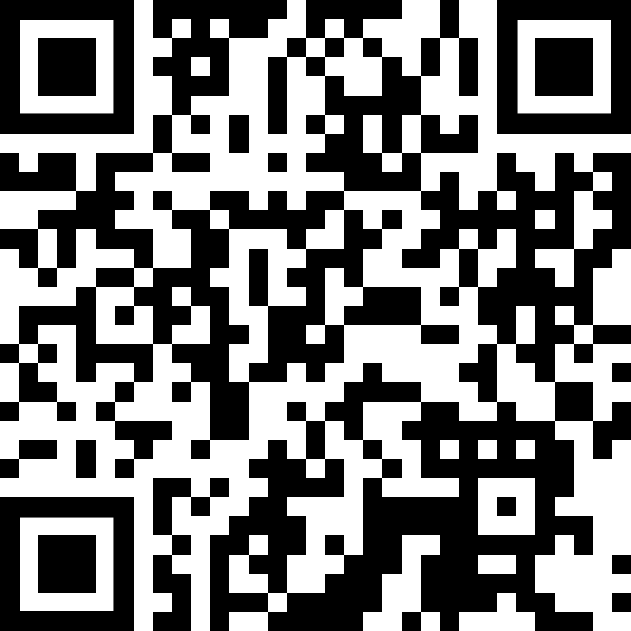
During Your Pregnancy
Birth & Bonding
Returning to Work & Nursing
What should I tell my employer if I need to take breaks to pump?
Talk to your employer in advance, if you can, about your needs for break time and space to pump.
Talk to your employer, if you can, about the frequency and duration of breaks you will need to express milk.
Visit https://www.dol.gov/agencies/whd/pump-at-work for information and contact your local WHD District Office if you have questions.

Slide 34
Compliance Assistance

Slide 35
WHD Resources
Additional information about the FLSA Protections to Pump at Work can be found at https://www.dol.gov/agencies/whd/pump-at-work
Fact Sheet # 73: FLSA Protections to Pump Breast Milk at Work
FAQs: FLSA Protections to Pump Breast Milk at Work
Field Assistance Bulletin No. 2023-02: Enforcement of Protections for Employees to Pump Breast Milk at Work
What to Expect from Your Employer When You’re Expecting http://www.dol.gov/agencies/whd/maternal-health

Slide 36
Additional Resources
Supporting Nursing Moms at Work: Employer Solutions http://www.womenshealth.gov/supporting-nursing-moms-work/what-law-says-about- breastfeeding-and-work/what-employers-need-know
National Conference of State Legislatures Compilation of State Breastfeeding Laws http://www.ncsl.org/health/breastfeeding-state-laws
Surgeon General’s Call to Action to Support Breastfeeding http://www.cdc.gov/breastfeeding/resources/calltoaction.htm
EEOC Enforcement Guidance on Disparate Treatment
http://www.eeoc.gov/laws/guidance/enforcement-guidance-unlawful-disparate-treatment- workers-caregiving-responsibilities
CDC Workplace Lactation Support Program Toolkit https://www.cdc.gov/breastfeeding/index.htm

Slide 37
WHD Compliance Assistance
Wage and Hour Division's toll-free help line
1-866-4-USWAGE (1-866-487-9243)
WHD Local Offices
https://www.dol.gov/agencies/whd/contact/local-offices
CORPS - Community Outreach and Resource Planning Specialists in Your Area
https://www.dol.gov/agencies/whd/CORPS
Sarah Decker, CORPS
Albany NY District Office
518-844-4178 / Decker.Sarah@dol.gov

Slide 38
Connect with Us
Connect with WHD: https://www.dol.gov/NEWSROOM/DIGITAL
WHD Twitter: https://twitter.com/whd_dol
DOL Facebook: https://www.facebook.com/departmentoflabor
DOL YouTube: https://www.youtube.com/user/USDepartmentofLabor
DOL Blog: https://blog.dol.gov/

Slide 39
Questions?

Slide 40
Disclaimer
This presentation is intended as general information only and does not carry the force of legal opinion. The Department of Labor is providing this information as a public service. This information and related materials are presented to give the public access to information on Department of Labor programs. You should be aware that, while we try to keep the information timely and accurate, there will often be a delay between official publications of the materials and the modifications of these pages. Therefore, we make no express or implied guarantees. The Federal Register and the Code of Federal Regulations remain the official source for regulatory information published by the Department of Labor. We will make every effort to keep this information current and to correct errors brought to our attention.
40

