Slide 1
APA NYC Metro Chapter: Navigating New Form I-9 and Remote Document Examination

Slide 2
Disclaimer
This presentation is intended for SHRM DC Chapter members. This presentation provides basic guidance about the rules and responsibilities during the employment eligibility verification process. This guidance may change. For up-to-date information, visit the uscis.gov/i-9-central website.
This presentation is not intended for paid distribution. USCIS reserves all rights in its trademarks and grants no license by providing this presentation. This presentation is not intended for members of the media. For all media inquiries visit the U.S. Citizenship and Immigration Services Media Contacts webpage.

Slide 3
Agenda
Background
Form I-9
Remotely Examining Documents
E-Verify Overview
Resources
Questions

Slide 4
Employment Eligibility Verification
Employment is often the magnet that attracts people to reside in the United States illegally.
Ensuring a legal workforce removes this magnet by requiring employers to hire only individuals legally authorized to work in the United States.

Slide 6
Background
Federal laws require that every employer in the U.S. must verify your employee's identity and employment authorization by completing Form I-9, Employment Eligibility Verification:
Immigration Reform and Control Act (IRCA)
Immigrant and Nationality Act (INA)
Illegal Immigration Reform and Immigrant Responsibility Act (IIRIRA) of 1996
Notes:
In 1986, Congress reformed U.S. immigration laws to preserve the tradition of legal immigration while seeking to close the door to illegal entry with the passage of the Immigration Reform and Control Act (IRCA). The employment eligibility verification provisions, and sanctions, of IRCA are found in Section 274A of the Immigration and Nationality Act (INA). These provisions further changed with the passage of the Immigration Act of 1990 and the Illegal Immigration Reform and Immigrant Responsibility Act (IIRIRA) of 1996.

Slide 7
Authorized Workers
The purpose of employment eligibility verification is to remove the incentive of illegal immigration by requiring employers to hire only individuals who may legally work in the United States*. Employees will attest to one of the following categories:
U.S. citizens
Noncitizen nationals
Lawful permanent residents
Noncitizens (aliens) authorized to work
*Includes: the 50 states, DC, Guam, Virgin Islands, Puerto Rico, and the commonwealth of the Northern Marianna Islands (CNMI)

Slide 8
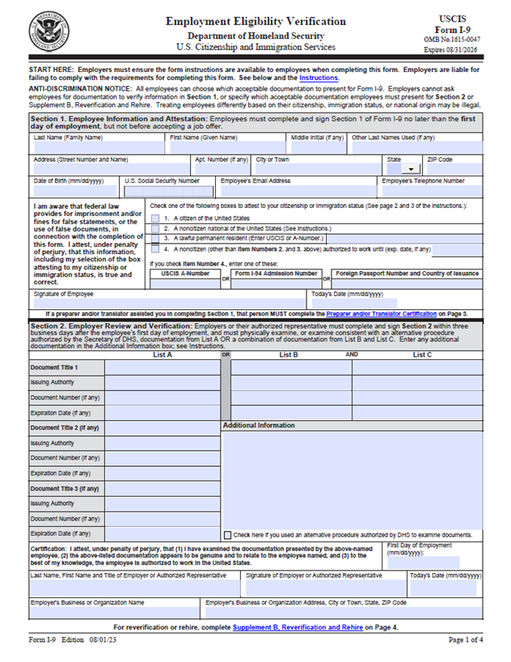
Form I-9, Employment Eligibility Verification
Verify the identity of all new employees
Verify the employment authorization of all new employees
Complete the most current version of Form I-9 (revision date 08/01/2023)
Retain Form I-9 for no less than three years:
Employed for less than 2 years: Retain Form I-9 for three years from hire date
Employed for more than 2 years: Retain Form I-9 for one year from termination date
Refrain from discriminating against individuals based on national origin or citizenship
** IMPORTANT LINKS **
I-9 Central
Handbook for Employers

Slide 9
Unlawful Conduct
The INA prohibits four types of unlawful conduct:
Citizenship or immigration status discrimination
Hiring, firing, or recruiting
National origin discrimination
Hiring, firing, or recruiting
Unfair documentary practices
Request more or different documents than required
Reject documents that reasonably appear to be genuine and relate to the employee
Specify certain documents that the worker should present
Retaliation or intimidation (actual or perceived)
Files charges with IER
Asserts rights under the law

Slide 10
Immigrant and Employee Rights (IER)
The anti-discrimination provisions of the INA are enforced by the
Department of Justice, Civil Rights Division Immigrant and Employee Rights.
Contact the IER regarding employment discrimination and employee rights and responsibilities.
(Both workers and employers may call anonymously)
Worker Hotline | 1-800-255-7688 | (TDD: 1-800-616-5525)
Employer Hotline | 1-800-255-8155 | (TDD: 1-800-362-2735)

Slide 11
Form I-9 Exceptions
Employers are NOT required to complete Form I-9 for:
Casual domestic service employees working in a private household when work is sporadic, irregular or intermittent
Independent contractors for whom you do not set work hours or provide tools to do the job
Employees working outside the United States
Individuals hired before November 6, 1986
Individuals employed by a contractor providing contract services and labor to you (such as temporary employment agencies)
Notes:
Form I-9 Exceptions:
Casual domestic service employees working in a private household when work is sporadic, irregular or intermittent. (i.e. handyman, babysitter, cleaning person)
Independent contractors for whom you do not set work hours or provide tools to do the job. Federal law prohibits individuals or businesses from contracting with an independent contractor knowing that the independent contractor is not authorized to work in the US
Employees working outside the United States.

Slide 12
Form I-9 Timelines

Slide 13
Question #1:
An employee must provide their Social Security number on Form I-9:
Always
Never
At the employer’s request
If the employer participates in E-Verify

Slide 14
Answer #1:
An employee must provide their Social Security number on Form I-9:
Always
Never
At the employer’s request
If the employer participates in E-Verify
Providing your 9-digit Social Security number in the Social Security number field is voluntary, unless your employer participates in E-Verify.

Slide 15
Section 1: Employee Information and Attestation
Section 1 is completed by the EMPLOYEE on or before the first day of work for pay:
Social Security Number is voluntary unless your employer participates in E-Verify
Attestation:
Citizen of the United States
Noncitizen National
Lawful Permanent Resident
Noncitizen Authorized to Work
Signature and Date
Preparer or Translator (Supplement A)

Slide 16
Supplement A: Preparer and/or Translator Certification for Section 1
Any individual who helps the employee complete and/or translates Section 1
Each preparer and/or translator must complete Supplement A
Preparer and/or translator should provide home address, not business address
Retain with the employee’s Form I-9
If no preparer and/or translator was required, do not retain Supplement A

Slide 17
Question #2:
True or False:
Employers may not accept documents with different names.

Slide 18
Question #2:
True or False:
Employers may not accept documents with different names.
FALSE:
You may accept a document with a different name than the name entered in Section 1 provided that you resolve the question of whether the document reasonably relates to the employee. You also may wish to attach a brief memo to Form I-9 stating the reason for the name discrepancy, along with any supporting documentation the employee provides. An employee may provide documentation to support their name change but is not required to do so. If, however, you determine that the document with a different name does not reasonably appear to be genuine and to relate to the employee, you may ask that they provide other documents from the Lists of Acceptable Documents on Form I-9.

Slide 19
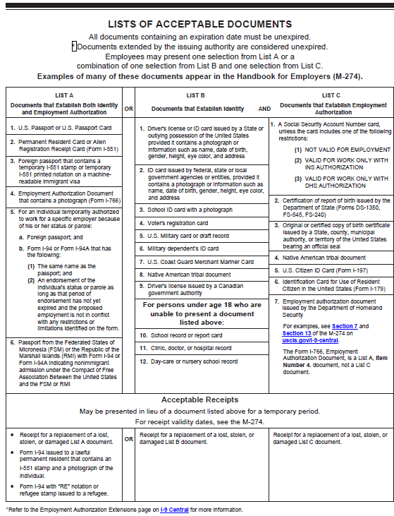
Lists of Acceptable Documents
Employee may present either:
List A document that establishes both identity and employment authorization
OR
List B document that establishes identity (for E-Verify employers, List B document must include photo)
AND
List C document that establishes employment authorization
You cannot specify which document(s) an employee will present from the list

Slide 20
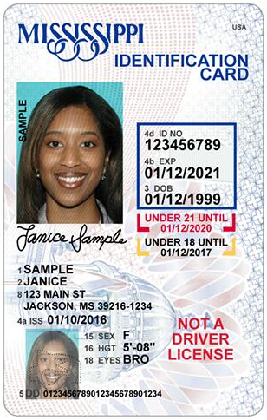
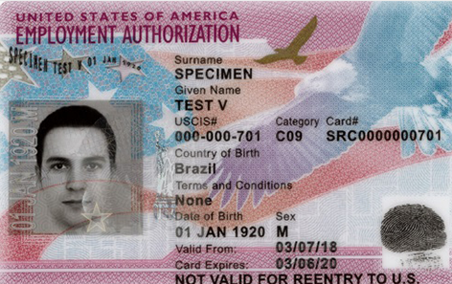
Section 2: Examining Documents
Acceptable documents must:
Be original (Photocopies are not permissible)*
Be unexpired**
Reasonably appear GENUINE
Relate to the individual presenting it
* You may accept a certified copy of a birth certificate
issued by a state, county, municipal authority or outlying possession of the United States that bears an official seal.
** Be mindful of recent automatic extensions for Form I-766, Employment Authorization Documents (EADs) and Form I-551, Permanent Resident Cards (PRCs).
** IMPORTANT LINKS **
Acceptable Document Examples
Receipts
Automatic Extensions

Slide 21
Authorized Representative
You may designate, hire, or contract with any person you choose to complete, update or make corrections to Section 2 or Supplement B on your behalf. This person is known as an authorized representative.
He or she must carry out full Form I-9 responsibilities
Employees CANNOT act as authorized representatives for their own Form I-9
You, the employer, are still liable for any violations
Examples of Authorized Representatives:
Personnel officer
Foreman
Agent
Supervisor
Notary Public

Slide 22
Question 3:
True or False:
If you elect to photocopy Form I-9 identity and employment authorization documents, you only need to do so for Non-Citizens and documents with which you are unfamiliar (i.e., foreign passport, temporary I-551 stamp, I-94, etc.).

Slide 23
Answer #3:
True or False:
If you elect to photocopy Form I-9 identity and employment authorization documents, you only need to do so for Non-Citizens and documents with which you are unfamiliar (i.e., foreign passport, temporary I-551 stamp, I-94, etc.)
FALSE:
If you make copies, they should be made consistently for all new hires and reverified employees, regardless of national origin, citizenship, or immigration status, or you may violate anti-discrimination laws.

Slide 24
Section 2: Photocopying Documents
Must photocopy List A Photomatching documents:
US Passport/Passport card
Permanent Resident Card (Form I-551)
Employment Authorization Card (Form I-766)
If you choose to make copies of an employee’s documents, you must do so for ALL employees
Retain document copies with their Form I-9 or their personnel record
Do not destroy or dispose of copies of documents
Copies of documents must be retained pursuant to Form I-9 retention rule
ICE IMAGE best practice
START COPYING DOCUMENTS | STOP COPYING DOCUMENTS
Create a policy memo | Create a policy memo
Copy ALL documents | Do not destroy or dispose of copies
Store with either Form I-9 or in employee’s personal record | Retain document copies pursuant to Form I-9 retention requirement

Slide 25
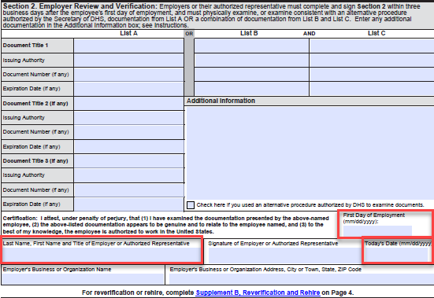
Section 2: Employer or Authorized Representative Review and Verification
Section 2 is completed by EMPLOYER:
MUST be completed no later than 3 business days after the employee’s first day of work for pay
Examine original, unexpired documents:
In the presence of employee
OR
Using the alternative procedure
Complete applicable document fields
Date Fields:
Today’s Date
First Day of Employment

Slide 26
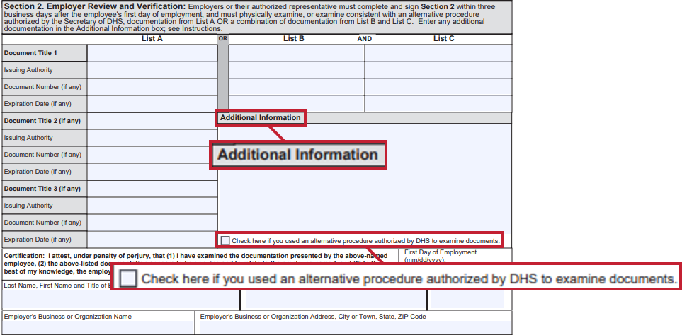
Section 2: Optional Remote Document Examination
E-Verify enrolled employers may remotely examine documents
To participate, employers must:
Review and retain copies of all documents
Conduct a live video interaction with new hire to view documents
Indicate use of the alternative procedure on the Form I-9
Notes:
ICE Published Federal Rule on July 25, 2023.
The Alternative Procedure goes into affect on August 1, 2023
E-Verify empowers document examination from anywhere: ICE published a Federal Register Notice that modernizes regulation to allow E-Verify enrolled employers to remotely examine Form I-9 documents.
The Notice provides an alternative for employers to remotely examine Form I-9 documents, instead of the current requirement to examine documents in-person.
Remote document examination using E-Verify maintains security, reduces employer burden, and supports the growing US remote workforce by building on the temporary flexibility instituted during the COVID-19 national emergency.
To participate, employers must be enrolled in E-Verify, review, and retain copies of all documents, and conduct a live video interaction with the new hire.
I-9 Central and E-Verify.gov have been updated to reflect the Form I-9 rules and regulations, to include new resources dedicated to remote document examination.

Slide 27
DHS Alternative Procedure: Obtain, Examine and Retain Form I-9 Document(s)
Employee transmits Form I-9 documentation to their employer
Employer conducts a live video interaction with the employee
Employee must show the same document(s) they transmitted
Employer examines the documents presented during the interaction to ensure they reasonably appear to be genuine and relate to the employee
Employer retains Form I-9 document copies with Form I-9

Slide 28
DHS Alternative Procedure: Annotate Form I-9

Slide 29
DHS Alternative Procedure: Conduct E-Verify Process

Slide 30
Key Questions and Answers
Q. May a qualified employer continue to examine documents physically instead of using the alternative procedure?
A. Yes. Use of this alternative procedure is entirely optional. Nothing in the alternative procedure prevents qualified employers from physically examining documents for the Form I-9.
Q. May a qualified employer offer the alternative procedure to only some employees?
A. No, qualified employers must allow employees who are unable or unwilling to submit documentation using the alternative procedure to submit documentation for physical examination. Nothing in the alternative procedure prevents an employer from physically examining documents when requested by an employee.

Slide 31
Key Questions and Answers (Continued)
Q. Can a qualified employer elect to use the alternative procedure on a person-by-person basis?
A. No, qualified employers who choose to use the alternative procedure must be consistent in offering it to all employees, except that a qualified employer may choose to offer the alternative procedure for remote hires only and continue to apply physical examination procedures to all employees who work onsite or in a hybrid capacity, so long as the employer does not adopt such a practice for a discriminatory purpose. Federal law prohibits discrimination in the Form I-9 and E-Verify processes, including discrimination based on citizenship, immigration status, or national origin under 8 U.S.C. 1324b.
U.S. Department of Justice, Immigrant and Employee Rights Section (IER), enforces the anti-discrimination provision of the Immigration and Nationality Act (INA), 8 U.S.C. 1324b. See 28 CFR. 44, available at https://www.justice.gov/ier (last visited May 24, 2023).

Slide 32
COVID-19 Temporary Policy: Form I-9 Requirement Flexibility Ending
COVID-19 temporary flexibilities for Form I-9 ended July 31, 2023:
Employers must complete in-person physical document inspections for employees whose documents were inspected remotely during the temporary flexibilities by August 31, 2023
Employers who were enrolled in E-Verify and remotely inspected documents pursuant to the temporary policy may now use the alternative procedure to remotely finalize Forms I-9
Form I-9 examples related to COVID-19 Policies
Notes:
Employers who were enrolled in E-Verify during the period of COVID temporary flexibilities (March 20, 2020 - July 31, 2023) which permitted remote document examinations, do not need to subsequently complete physical examination of documents.
Employers not enrolled in E-Verify (at the time of the remote examinations during COVID flexibilities) are required to physically examine all documents including those virtually examined during the pandemic. These employers may use an authorized representative to complete physical examinations at remote hiring sites.
After the expiration of COVID flexibilities, only E-Verify enrolled employers may remotely examine documents (beginning August 1, 2023).

Slide 33
Supplement B: Reverification and Rehires
Supplement B is completed by Employer:
Required when employee’s employment authorization or documentation of employment authorization has expired
May be completed when rehiring employees within three years of hire date
May be completed to document a legal name change
Do NOT create another E-Verify case

Slide 34
Question #4:
Reverification is required for:
Expired driver’s licenses
Expired US Passports
Expired employment authorization documents or status
All of the above

Slide 35
Answer #4:
Reverification is required for:
Expired driver’s licenses
Expired US Passports
Expired employment authorization documents or status
All of the above
You must reverify an employee’s employment authorization no later than the date employment authorization expires. The employee must present a document that shows current employment authorization, such as any documentation from List A or C

Slide 36
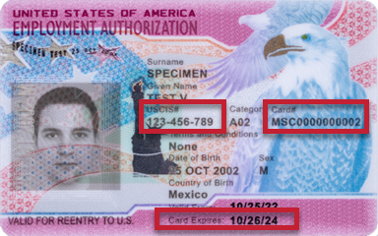
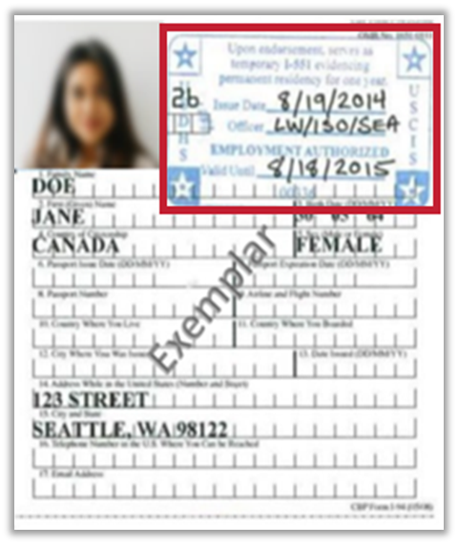
Supplement B: Reverification and Rehires
Do NOT Reverify | Reverify
U.S. Citizens | Employment Authorization Documents (Form I-766)
Noncitizen Nationals | Temporary I-551 stamp located on Form I-94
Unexpired Permanent Resident cards (LPR cards; Form I-551) | Temporary I-551 stamp located in a foreign passport
List B Documents | Expired Permanent Resident card presented with Form I-797

Slide 37
Storage
How to store Form I-9:
Store Form I-9s securely in a way that meets your business needs
On-site or at an off-site facility
Microfilm or Microfiche
Electronically
Ensure that only authorized personnel have access to stored Forms I-9
Store copies of documents with the Form I-9 or with the employee’s records
Forms I-9 must be available within 3 days of an official request for inspection
** RELEVANT LINK **
Form I-9 Retention and Storage

Slide 38
Retention
You must have a Form I-9 on file for ALL current employees.
EMPLOYEE: John Smith
DATE OF HIRE: November 1, 2020
EMPLOYMENT ENDED: May 5, 2022
TENURE: Less than 2 years
RETENTION: 3 years from DATE OF HIRE
EMPLOYEE: BETSY ROSS
DATE OF HIRE: November 1, 2002
EMPLOYMENT ENDED: May 5, 2023
TENURE: More than 2 years
RETENTION: 1 year from END DATE
RETAIN UNTIL: NOVEMBER 1, 2023
RETAIN UNTIL: MAY 5, 2024
Calculate how much longer you must keep an employee’s Form I-9 once they stop working for you:
If they worked for less than two years, retain their form for three years after the date of hire
OR
If they worked for more than two years, retain their form for one more year after the date they stop working for you

Slide 39
Internal Audits
It is a best practice to conduct an internal audit on Forms I-9 annually:
Develop a transparent process
Arrange for annual Form I-9 audit by an external auditing firm or a trained employee not otherwise involved in the Form I-9 process
Review all Forms I-9 or a sample of Forms I-9 based on neutral and non-discriminatory criteria
Audits should be carefully conducted to prevent even the perception of discrimination or retaliation
ICE Mutual Agreement between Government and Employers best practice
** RELEVANT LINK **
Guidance for Conducting Internal Audits

Slide 40
Correcting Form I-9
If you discover a mistake on Form I-9:
Only employees may correct errors or omissions in Section 1
Only employers or authorized representatives may correct errors or omissions in Section 2 and Supplement B
Draw a line through incorrect information
Do not conceal errors by erasing text or using correction fluid
Enter the correct or missing information
Initial and date the correction or missing information
To correct multiple errors, redo the section on a new Form I-9 and attach it to the old form. Attach a written explanation describing why you created a new Form I-9

Slide 41
Correcting Form I-9 (Continued)
If you discover you are missing the Form I-9 for an employee:
Complete the form as soon as possible
Do not backdate the form
Attach a signed and dated explanation
If you discover the wrong version of the Form I-9 was completed:
Confirm documentation presented was acceptable under Form I-9 rules that were current at the time of hire
Staple outdated form to a blank current version
Sign the current blank version and provide an explanation
** RELEVANT LINK **
Correcting Mistakes

Slide 42
Form I-9 Best Practices
Form I-9 is only completed when an offer of employment has been extended and accepted
Use the most current version of Form I-9 (revision date 08/01/2023)
Provide all employees with the full instructions including the Lists of Acceptable documents
Employee may present any acceptable List A or combination of List B and List C documents
Do not specify documents to present
Accept documents that relate to the individual and reasonably appear GENUINE
Reverify expiring employment authorization and employment authorization documents
Physically inspect documents previously remotely inspected when appropriate
Retain Forms I-9 pursuant to retention rules
Conduct timely audits to ensure compliance
Do not discriminate based on national origin or citizenship

Slide 43
What is E-Verify?
Free web-based service that’s fast and easy to use
Electronically verifies the employment eligibility of:
Newly hired employees
Existing employees assigned to work on a qualifying federal contract*
Partnership between the U.S. Department of Homeland Security (DHS) and the Social Security Administration (SSA)
Required for Form I-9 Remote Document Examination
* Contracts that includes the E-Verify Federal Acquisition Regulation (FAR) clause
Confirm with Confidence
ENROLL NOW

Slide 45
Confirming Employment Eligibility
E-Verify is a FREE, Internet-based system that compares information entered by an employer from an employee’s Form I-9 to records available to the U.S. Department of Homeland Security and the Social Security Administration to confirm employment eligibility.

Slide 46
E-Verify Benefits
Works seamlessly with Form I-9
Multiple user accounts for ultimate flexibility
Eliminate guesswork with document and photo matching
Custom resources and tools for administrators
Peace of mind through confirmed employment eligibility
Secure web-based tool with 24-hour access
Near instant verification in as little as 3-5 seconds
Ensuring a legal workforce

Slide 47
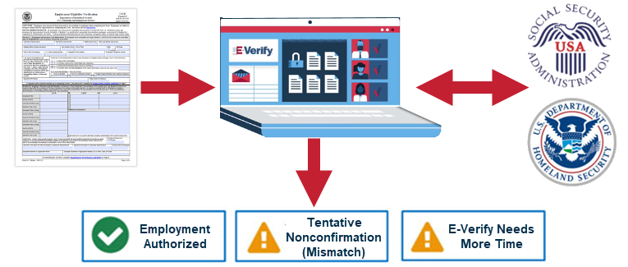
E-Verify Process
Form I-9 information is entered into E-Verify and then compared against records available to the Social Security Administration and the Department of Homeland Security.
After a case is submitted, you will receive an immediate result of either
Employment Authorized, Tentative Nonconfirmation, or Verification in Process.

Slide 48
E-Verify NextGen – COMING SOON
NextGen is an exciting new product that modernizes and streamlines the Form I-9 and verification process for employees and employers.
Feature | Benefits
 | Employee | Employer
Will allow employees to enter their own personal information and documents | More privacy and security for your personal information. | Improves efficiency and reduces data entry errors.
Direct notification of employment status | Immediate notification, in most cases, if further action is needed to determine employment eligibility, including next steps. | Eliminates the need, in most cases, for employers to deliver Further Action Notices to employees.
Will carry verification status over to new employment | Update and share your employment eligibility status with new employers. | Seamless integration with E-Verify, allowing you to manage all cases in one place.
E-Verify NextGen Overview Video

Slide 49
Resources
I-9 Central
I-9 Central Español
Form I-9 Documents
Handbook for Employers
Natural Disaster Fact Sheet
Mergers and Acquisitions
E-Verify
E-Verify User Manual
Click here to
Enroll in E-Verify
Stay Informed!
Follow us on Facebook, Twitter, YouTube, LinkedIn and sign up for email updates through GovDelivery

Slide 50
Customer Support
Our best-in-class Customer Support team is available to assist you with E-Verify cases, policies, and procedures, Form I-9, employment eligibility, and technical support.
HOURS: Monday through Friday, 8 a.m. – 8 p.m. Eastern
Form I-9 E-Mail: I-9Central@uscis.dhs.gov
E-Verify E-Mail: E-Verify@uscis.dhs.gov
Employer Hotline: (888) 464-4218
Employee Hotline: (888) 897-7781

Slide 51
Engagement Services: Free Webinars
E-Verify and Form I-9 webinars are free and easy to join! Find the ones you like and bring a friend. View upcoming events on the following topics:
Form I-9
E-Verify Overview
E-Verify in 30*
E-Verify for Existing Users
E-Verify for Federal Contractors
E-Verify for Web Services
myE-Verify*
Employee Rights
Employer Responsibilities
*Topics NOT eligible for professional development credit through the Society for Human Resource Management (SHRM) and the Human Resource Certification Institute (HRCI).

Slide 52
Engagement Services: Customized Events
E-Verify Engagement will work with you to provide content suited to fit your needs:
Customized trainings tailored to your business:
Form I-9
E-Verify overview
Employment eligibility verification specialized topics
Keynote speakers available for your:
Conference, forum, event
Lunch and learns
BONUS: E-Verify Engagement staff can work with you to discuss SHRM and HRCI possible professional development credits.

Slide 53
QUESTIONS?

Slide 54
THANK YOU!

