Slide 1
OVERVIEW: WAGE AND HOUR DIVISION

Slide 2
WHD MISSION
To promote and achieve compliance with labor standards to protect and enhance the welfare of the nation's workforce.

Slide 3
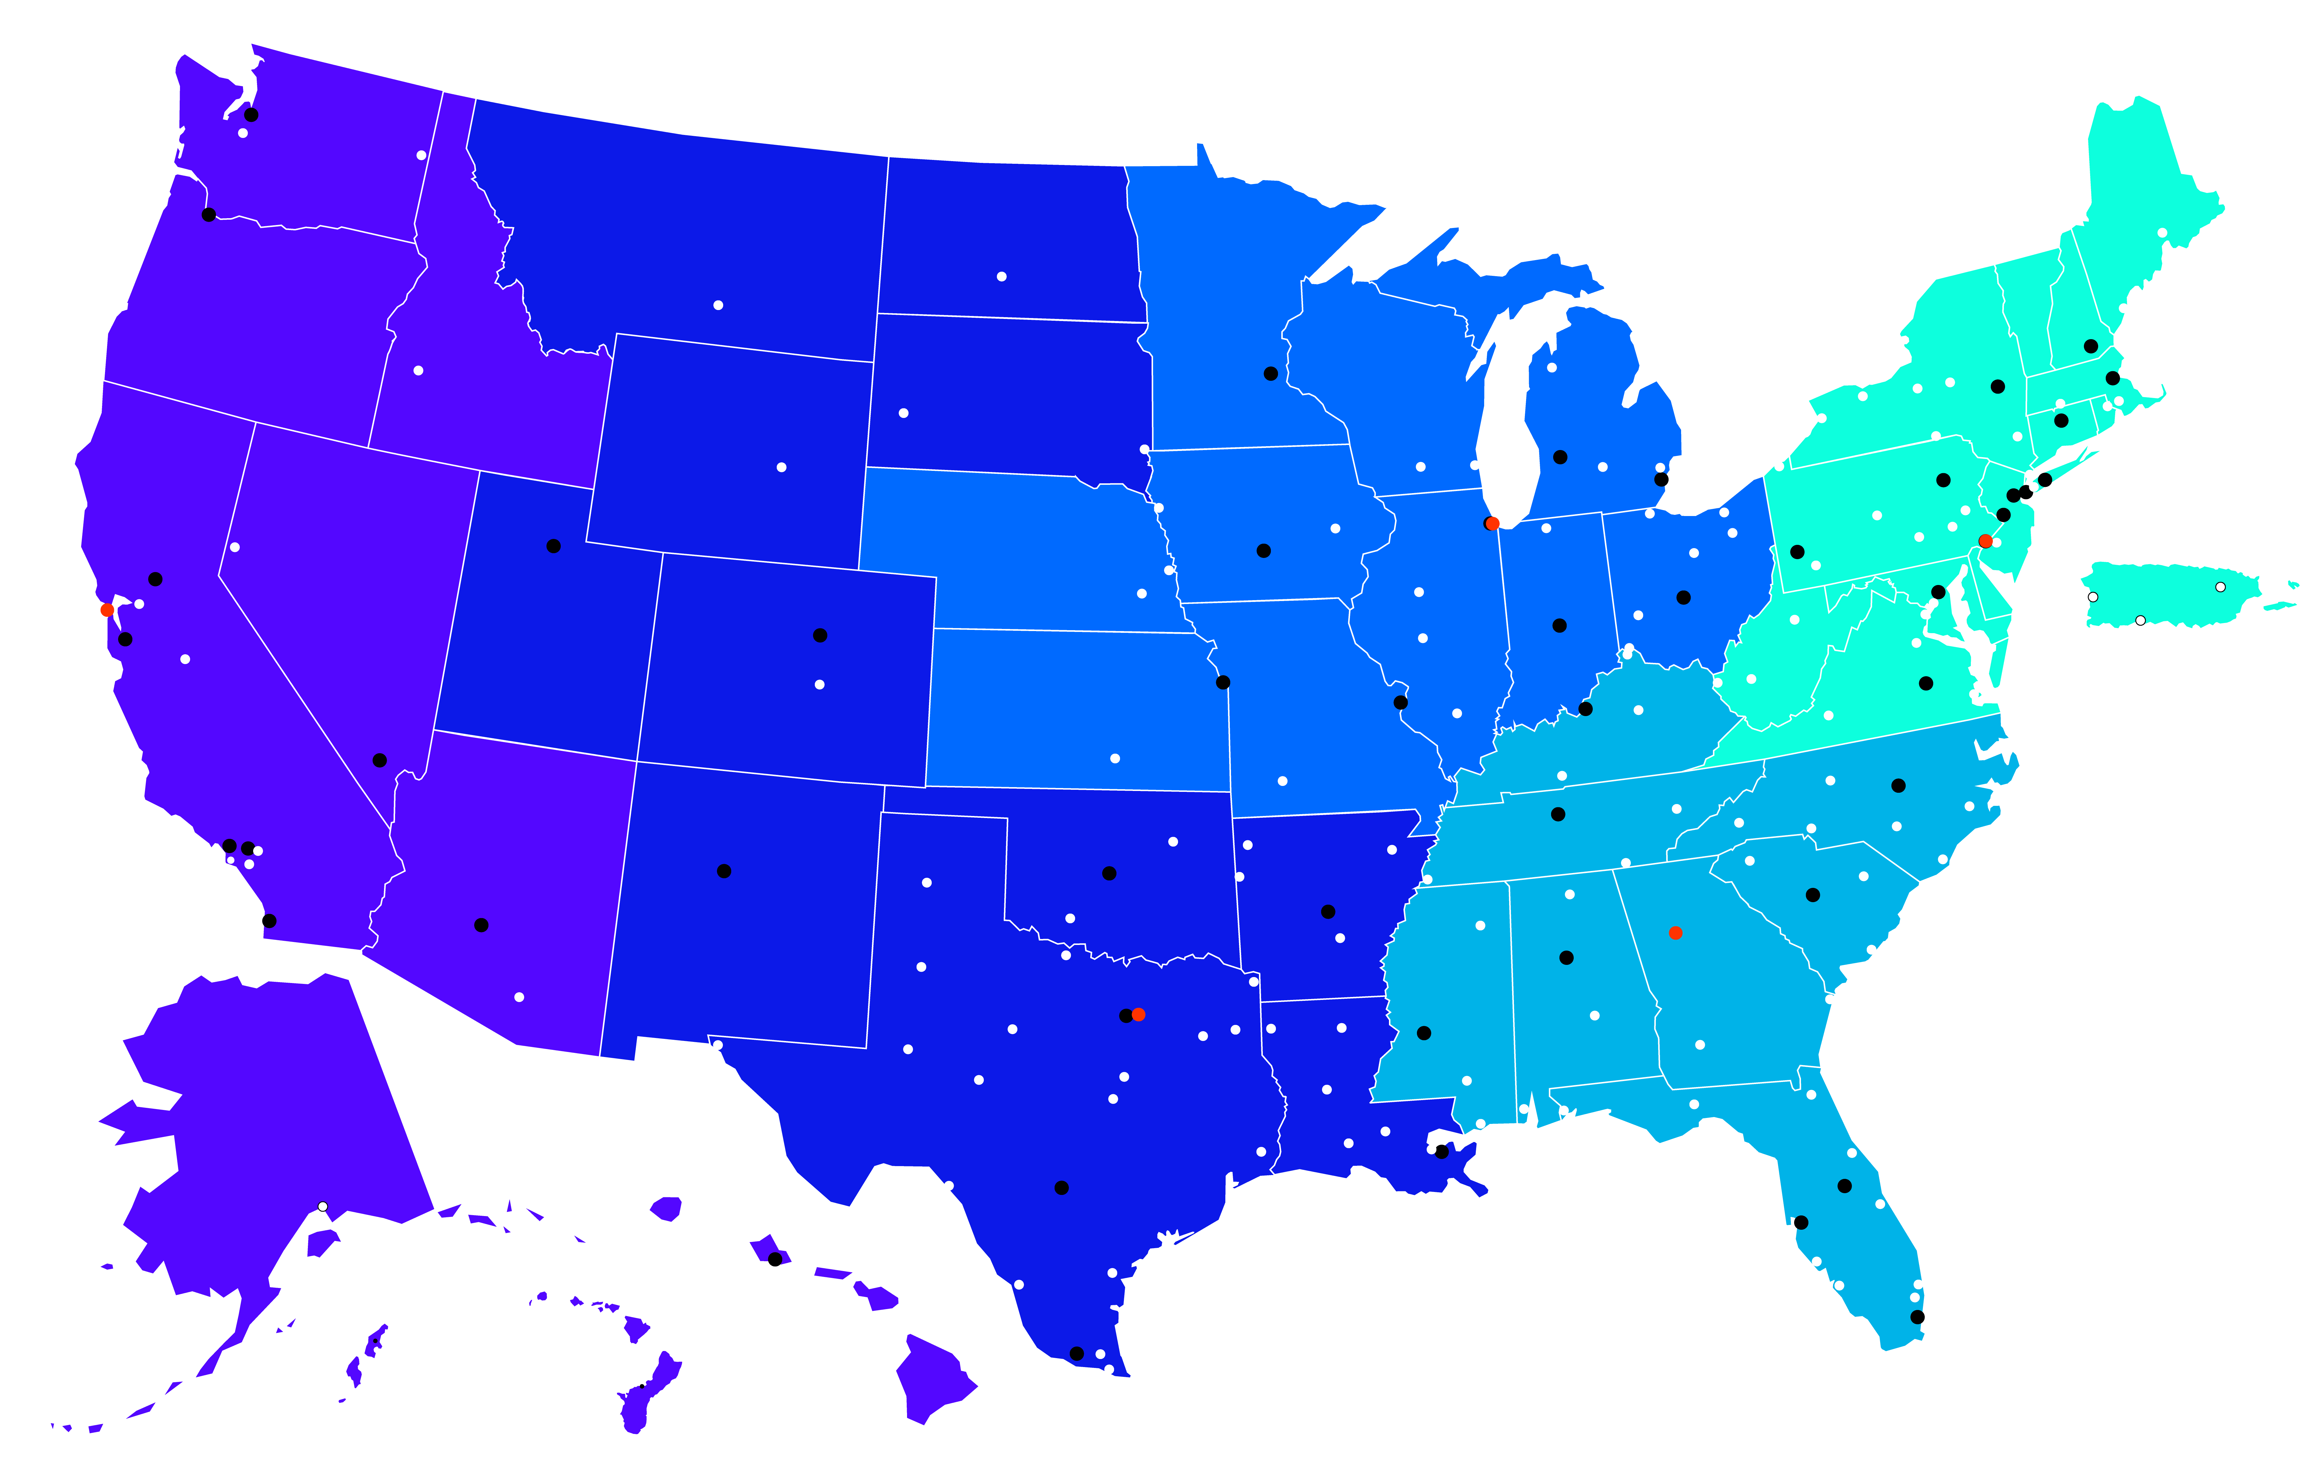
WHD OFFICES
Find the office closest to you here.

Slide 4
LAWS ENFORCED BY WHD
Fair Labor Standards Act
Temporary Worker Programs (H-2A, H-2B, and H-1B)
Family and Medical Leave Act
Davis Bacon and Related Acts
The Migrant and Seasonal Agricultural Worker Protection Act
The Service Contract Act
OSHA Field Sanitation Standards
Employee Polygraph Protection Act

Slide 5
Enforcement Regardless of Immigration Status
Labor laws cover all workers, regardless of immigration status
Protections apply regardless of immigration status
WHD does not ask workers about their immigration status

Slide 6
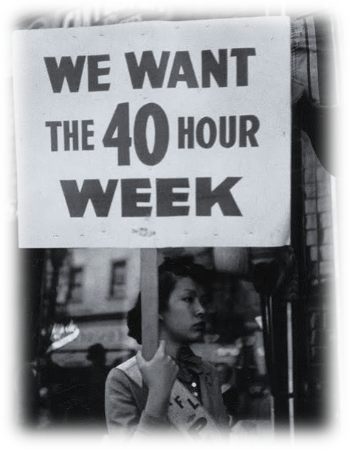
The Fair Labor Standards Act (FLSA)
Essential Protections:
Minimum wage: $7.25 per hour
Overtime at “time and one-half” for hours worked over forty in a workweek
Recordkeeping requirements
Prohibited youth employment
Anti-retaliation provisions
Fact Sheet #14

Slide 7
The FLSA and Youth Employment
Federal youth employment rules set both hours and occupational standards for youth.
16 and 17 year olds
Unlimited hours; may work in any occupation other than those declared hazardous by Secretary of Labor
14 and 15 year olds
May work outside school hours and for limited periods of time; only non-manufacturing, non-hazardous jobs, and specific conditions apply
Children under 14
With limited exceptions, no employment permitted in covered, non-agricultural occupations
Fact Sheet #43

Slide 8
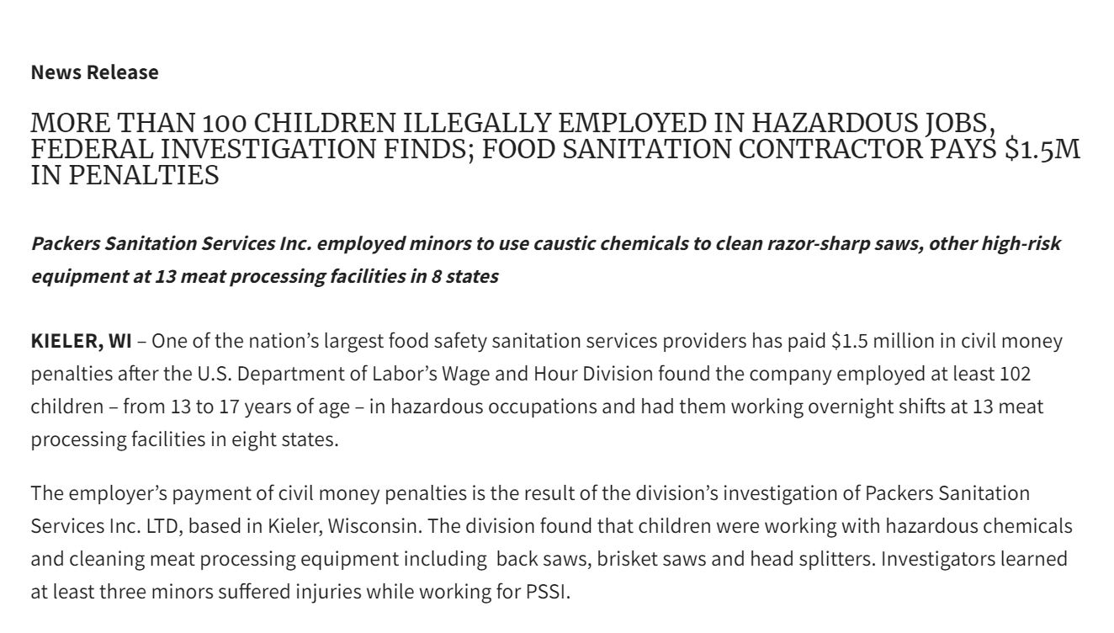
The FLSA and Child Labor (cont.)
Link to press release

Slide 9
The FLSA and Rest Breaks for Nursing Mothers
Section 7 of the FLSA was amended by the Affordable Care Act to provide nursing employees, for up to 1 year after the child’s birth, with:
Reasonable break time to express breast milk
A place, other than a bathroom, that may be used to express milk
Fact Sheet #73

Slide 10
The FLSA and Section 14(c)
Section 14(c) of the FLSA authorizes the employment of workers with disabilities at subminimum wages when their disabilities impair their productivity
for the work being performed.
A subminimum wage (SMW) can be paid to workers with disabilities when their disability impairs their productive and earning capacities for the work being performed
SMW must be commensurate with the workers’ productivity as compared to the wage and productivity of experienced workers who are not disabled for the work
SMW can only be paid when authorized by a certificate issued to the employer by DOL. Employing a worker with a disability does not in and of itself justify the payment of a SMW.
Fact Sheet #39

Slide 11
The Visa Programs
The Wage & Hour Division enforces the employer’s contractual obligations under the following visa programs:
H-2A: Where there is a shortage of U.S. workers to perform manual farm work, the H-2A program allows foreign agricultural workers to enter the country on a temporary basis under appropriate conditions.
H-2B: The Immigration and Nationality Act (INA) provides for the admission of nonimmigrants in the H-2B visa classification to perform temporary non-agricultural labor or services in the United States.
H-1B: Temporary employment of foreign workers in the United States in specialty occupations or as fashion models.

Slide 12
H-2B Temporary Nonimmigrant Worker Visa Program Enforcement
Wage and Hour Division
U.S. Department of Labor
Wage and Hour Division

Slide 13
This Presentation
This presentation will:
Summarize H-2B program compliance principles under the 2015 Interim Final Rule (2015 Rule);
Identify common violations; and
Review the investigatory process.
This presentation will not:
Discuss responsibilities of other agencies; or
Summarize any H-2B rules prior to the 2015 Rule.

Slide 14
The H-2B Visa Program
The Immigration and Nationality Act (INA) provides for the admission of nonimmigrants in the H-2B visa classification to perform temporary non-agricultural labor or services in the United States. 8 U.S.C. §1101(a)(15)(H)(ii)(b).
The Department of Homeland Security (DHS) delegated H-2B enforcement responsibility to WHD on January 18, 2009 for all Applications for Temporary Employment Certifications filed on or after that date.
Regulations: 20 CFR part 655, 29 CFR part 503

Slide 15
WHD’s H-2B Enforcement Responsibility
Whether the employer conducted the required recruitment for U.S. workers.
Whether U.S. workers were offered employment.
Whether U.S. workers were improperly laid off or displaced.
Review of job order and certification obligations, including wages and working conditions, for H-2B workers and protected U.S. workers.
Poll Question #1

Slide 16
U.S. Worker Protections
Employer Obligations to U.S. Workers

Slide 17
U.S. Worker Recruitment Requirements
The employer must:
Submit a job order to the State Workforce Agency (SWA), which must remain open until 21 days before the employer’s first date of need;
Place a newspaper advertisement on two separate days, one of which must be a Sunday;
Contact its former U.S. employees;
Maintain a recruitment report.

Slide 18
U.S. Worker Hiring Requirements
The employer must hire qualified U.S. applicants and may not refuse to hire the U.S. applicants for discriminatory reasons.
Employers must not impose any restrictions or obligations on U.S. workers that will not also be imposed on H-2B workers.
Each job qualification and requirement must be listed in the job order
Poll Question #2

Slide 19
Prohibition of Preferential Treatment
An employer must offer U.S. workers terms and working conditions at least as favorable as those offered or provided to H-2B workers.

Slide 20
Prohibition of U.S. Worker Layoff or Displacement
The employer may not layoff its U.S. employees in the period beginning 120 days before the date of need through the end of the certification.
If such a layoff has occurred in the period beginning 120 days before the first date of need, the employer must contact those former workers and solicit their return to the job.
If a lawful, job-related layoff is necessary after H-2B workers have arrived, the employer must layoff all H-2B workers before laying off U.S. workers.

Slide 21
Additional Assurances and Obligations

Slide 22
Payment of Required Wages
The offered wage must equal or exceed the highest of the:
Prevailing wage obtained from ETA, or
federal, state, or local minimum wage.
The employer must pay the offered wage during the entire period of employment.
Wages must be paid free-and-clear.
The employer must pay at least every two weeks, or the prevailing frequency in the geographical area.

Slide 23
Travel Time and Hours Worked
Ordinary home-to-work travel is not work time
Travel between job sites during the normal work day is work time
If an employee is required to report to a meeting place to receive instructions, perform other work there, or to pick up equipment or tools, the travel from the designated meeting place to the work places is part of the day’s work and must be counted as hours worked.
If the employee is required to return to the employer’s office or job site, the travel time back to the office is counted as hours worked.

Slide 24
Tools, Equipment, and Deductions
Employers must make all deductions required by law.
Deductions not required by law must be disclosed in the job order and must be reasonable.
Deductions for expenses that are for the primary benefit of the employer are not reasonable and therefore may not bring an employee’s wages below the H-2B required wage rate.
The employer must provide workers all tools, supplies, and equipment required to perform the assigned duties at no cost to the worker.

Slide 25
Disclosure
The employer must provide a copy of the job order to both the H-2B workers and protected U.S. workers.
H-2B workers who are abroad must receive the job order no later than when they apply for the visa.
H-2B workers already in the U.S. must receive the job order no later than when the job offer is made.
Job order must be provided in a language understood by the worker.

Slide 26
Transportation and Visa Fees
Inbound transportation:
The employer must provide or pay for transportation and daily subsistence to the place of employment or reimburse workers when 50% of the job order has elapsed.
Outbound transportation:
The employer must provide or pay for return transportation and subsistence if the worker completes the job order period or is dismissed early with or without cause.
Visa fees:
Employer is always liable for visa fees & related expenses in or before the first workweek.

Slide 27
Place of Intended Employment & Job Classification
The employer must not place an H-2B worker outside the area of intended employment listed on the job order.
The employer is also prohibited from placing H-2B workers outside the certified occupation listed on the job order.
Poll Question #3

Slide 28
Prohibited Fees
The employer, its agent, and its attorneys must not seek or receive payments from workers related to the certification, including agent or attorney fees and recruitment costs.
The employer must contractually forbid any agent or recruiter whom the employer engages directly or indirectly in international recruiting from seeking or receiving payments from prospective workers.

Slide 29
Other H-2B Program Obligations
The job must be a bona-fide, full-time temporary position, with full time defined as 35 or more hours per week
There must be no strike or lockout at any of the employer’s worksites in the same geographic area
Display workers’ rights poster
Provide an earnings statement to each worker on or before each payday.
Retain required documents for 3 years.

Slide 30
Other H-2B Program Obligations
Cooperate with WHD investigators.
Notify ETA and DHS in writing within two days if a worker separates prior to the end date of employment certified in the Application.
Not intimidate, threaten, discharge, or discriminate against any person who has exercised their rights under the H-2B program.
Comply with other applicable laws.
FLSA overtime
Poll Question #4

Slide 31
Investigations
Meeting(s) with the employer
Tour of the establishment
Records review
Confidential interviews with employees
Determination Letters (if applicable)
Fact Sheet #44

Slide 32
Sanctions and Remedies
Recover unpaid wages
Seek make whole relief, instatement, or reinstatement for laid off or improperly rejected U.S. workers
Assess civil money penalties
Debar the employer, attorney, and/or agent for up to 5 years
Recommend to ETA that current certification be revoked
WHD Fact Sheet #44

Slide 33
Statutes Prohibiting Retaliation
An employer is prohibited from retaliating against an individual or threatening to retaliate against an individual for exercising or attempting to exercise their workplace rights under these laws and programs:
The Fair Labor Standards Act (FLSA)
The Family and Medical Leave Act (FMLA)
The H-2A Visa program (H-2A)
The H-2B Visa program (H-2B)
The Migrant and Seasonal Agricultural Worker Protection Act (MSPA)
Executive Order Establishing a Minimum Wage for Contractors (E.O. 13658)
Executive Order Establishing Paid Sick Leave for Federal Contractors (E.O.13706)
Executive Order Increasing the Minimum Wage for Federal Contractors (E.O. 14026)
WHD Fact Sheet #44

Slide 34
H-2B Resources
Visit the Wage & Hour Division’s H-2B website https://www.dol.gov/agencies/whd/immigration/h2b where you will find...
H-2B Posters
Fact Sheets
General Guidance
The Regulations
Key News, and more.

Slide 35
Additional Information
Visit www.dol.gov/agencies/whd
Call our toll-free information and helpline at 1-866-4US-WAGE (1-866-487-9243)
Call or visit the nearest Wage and Hour Division Office: https://www.dol.gov/agencies/whd/contact
Sarah Decker Outreach Specialist Albany, NY District Office Phone: (518) 844-4178 Email: decker.sarah@dol.gov

Slide 36
This presentation is intended as general information only and does not carry the force of legal opinion. The Department of Labor is providing this information as a public service. This information and related materials are presented to give the public access to information on Department of Labor programs. You should be aware that, while we try to keep the information timely and accurate, there will often be a delay between official publications of the materials and the modification of these pages. Therefore, we make no express or implied guarantees. The Federal Register and the Code of Federal Regulations remain the official source for regulatory information published by the Department of Labor. We will make every effort to keep this information current and to correct errors brought to our attention.
Disclaimer

