Slide 1
Payroll Pointers for filers of forms w-2/w-3
SSA Regional Employer Services Liaison Officers
www.ssa.gov/employer/wage_reporting_specialists.htm

Slide 2
my Social Security
www.ssa.gov/myaccount
www.ssa.gov/retire
www.ssa.gov/applyfordisability/

Slide 3
Employer services welcome page
www.ssa.gov/employer

Slide 4
Bso welcome page
www.ssa.gov/bso/bsowelcome

Slide 5
Business Services Online
Register for a User ID and password
File W-2s
W-2 Online
W-2c Online
Test Wage File (AccuWage Online)
Upload Wage File
Notices via e-mail
Verify Employee Names and SSNs

Slide 6
What do I do first?
Register – as an individual on behalf of the employer
User ID
Electronic signature of person, not company, attesting to proper use of the service
Allows a person access to Business Services Online (BSO)
Must use your BSO User ID issued by SSA, not your “my Social Security” username

Slide 7
Registration Process
Provide registration information (you the user)
Choose your own password
Receive your User ID
Choose your role(s)
Employer information
Notices
Sent to user
Sent to employer (Activation Code)

Slide 8
Registration reminders
User IDs valid indefinitely
Passwords valid for 90 days
Receive your User ID
For Assistance – Call 1-800-772-6270

Slide 9
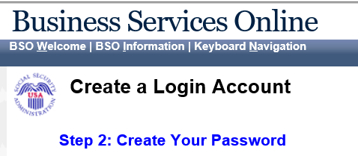
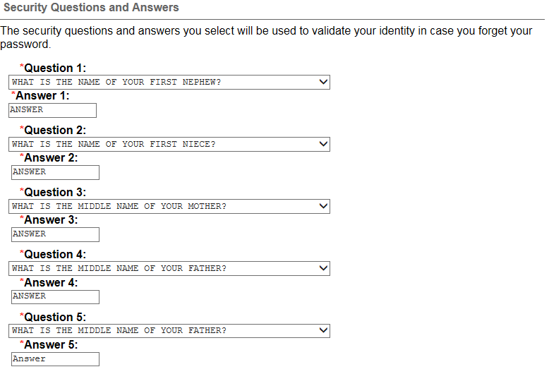
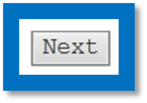
Create Your Password

Slide 10
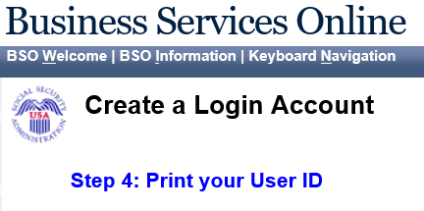
Print your User ID

Slide 11
Reminders for ty 2021
Employee Tax Rate 7.65%
Self-Employed Tax Rate 15.30%
Social Security (OASDI only) Maximum Taxable Earnings $142,800
Medicare (HI only) – No limit taxable earnings
January 31st - deadline to file W-2s using BSO or to submit paper Form W-2.
January 31- deadline to distribute Forms W-2 to employee(s)

Slide 12
Submit, upload or process W-2s and W-2Cs
Upload EFW2 or EFW2C file
Prepared by your software
Large or small filers
W-2/W-2C Online
Ideal for small filers or special needs
Blank W-2 displayed via Internet
W-3/W-3C totaled for your records
Name/SSN verification occurs immediately
Employee Copies
Prefill information you submitted in W-2 Online last year
No forms or tax
software required!!!

Slide 13
Report Wages to Social Security

Slide 14
Electronic Wage Reporting (EWR)

Slide 15
Before you Start (EFW2)

Slide 16
What’s In the File? (EFW2)

Slide 17
Submit your file (EFW2)

Slide 18
Confirmation – Your File Was Received (EFW2)

Slide 19
forms w-2/w-3 online

Slide 20
W-2 Online Facsimile

Slide 21
Forms W-2/W-3 Online

Slide 22
Forms W-2/W-3 Online

Slide 23
Forms W-2/W-3 Online

Slide 24
Forms W-2/W-3 Online

Slide 25
What is the Social Security Number Verification Service (SSNVS) ?
Allows employers to verify the name and SSN of a hired employee with Social Security (SSA) over the Internet
Cannot be used for tax filing purposes
Only tells you if name & Social Security Number match SSA’s records – not identity
4 possible “No-Match Codes” returned
Provides an indicator if Social Security Number belongs to a deceased person

Slide 26
Two Methods for using ssnvs
Direct keying to SSNVS website
Key up to 10 names/SSNs with immediate results
Can key multiple screens
Upload file
Can upload up to 250,000 SSNs per file
Next business day results

Slide 27
SSN Verification Page

Slide 28
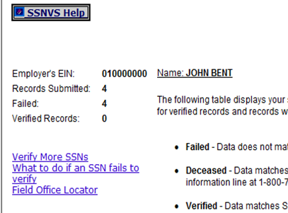
SSN Verification Results

Slide 29
POSSIBLE MISMATCH CODES
VERIFICATION CODES
1 = SSN not in file (never issued to anyone)
3 = Name and SSN match; DOB does not match
5 = Name and SSN does not match, DOB not checked
6 = have employee contact the local Social Security office for more information
DECEASED (PER SSA RECORDS)
If Social Security records indicate any of the names and SSNs submitted for verification belonged to deceased individuals, the page will display a table with the information pertaining to these requests.

Slide 30
What to do if an ssn fails verification
Compare submitted information
Ask employee to verify the information/View SSN card
Ask employee to check with local Social Security office
Document your efforts

Slide 31
Ssnvs reminders
A mismatch is not a basis, in and of itself, for you to take any adverse action against an employee, such as laying off, suspending, firing, or discriminating.
Company policy should be applied consistently to all workers.
Any employer that uses the mismatch information to take adverse action against a worker may violate State or Federal law.
The information from SSNVS does not make a statement regarding a worker’s immigration status.

Slide 32
SSA is Here to Help
www.ssa.gov/employer
General Wage Reporting Questions – 1-800-772-6270 or by email at employerinfo@ssa.gov
BSO technical Help 1-888-772-2970 or by email at bso.support@ssa.gov
Employer Services Liaison Officers (ESLO)
Social Security Administration Website
Business Services Online Registration Tutorial Video
Electronic filing W-2 Handbook

Slide 33
Questions?

