Slide 1
ERISA BASICS & What to expect from an ebsa Investigation
Employee Benefits Security Administration

Slide 2
disclaimer
This presentation may contain opinions of the presenter that may not comport with the official views of the U.S. Department of Labor and is meant for educational purposes only.

Slide 3
EBSA’s Mission statement
The Employee Benefits Security Administration protects the security of the retirement, health and other workplace related benefits of American workers and their families. Our Agency accomplishes this by:
developing effective regulations
assisting and educating workers, plan sponsors, fiduciaries and service providers
vigorously enforcing the law

Slide 4
ERISA & laws contained in part 7 of erisa
Employee Retirement Income Security Act of 1974 (ERISA)
Patient Protection and Affordable Care Act of 2010 (Affordable Care Act)
Mental Health Parity and Addiction Equity Act of 2008 (MHPAEA)
Health Insurance Portability and Accountability Act (HIPAA Title I)
Women’s Health and Cancer Rights Act (WHCRA)
Newborns’ and Mothers’ Health Protection Act (Newborns’ Act)
Genetic Information Nondiscrimination Act of 2008 (GINA)

Slide 5
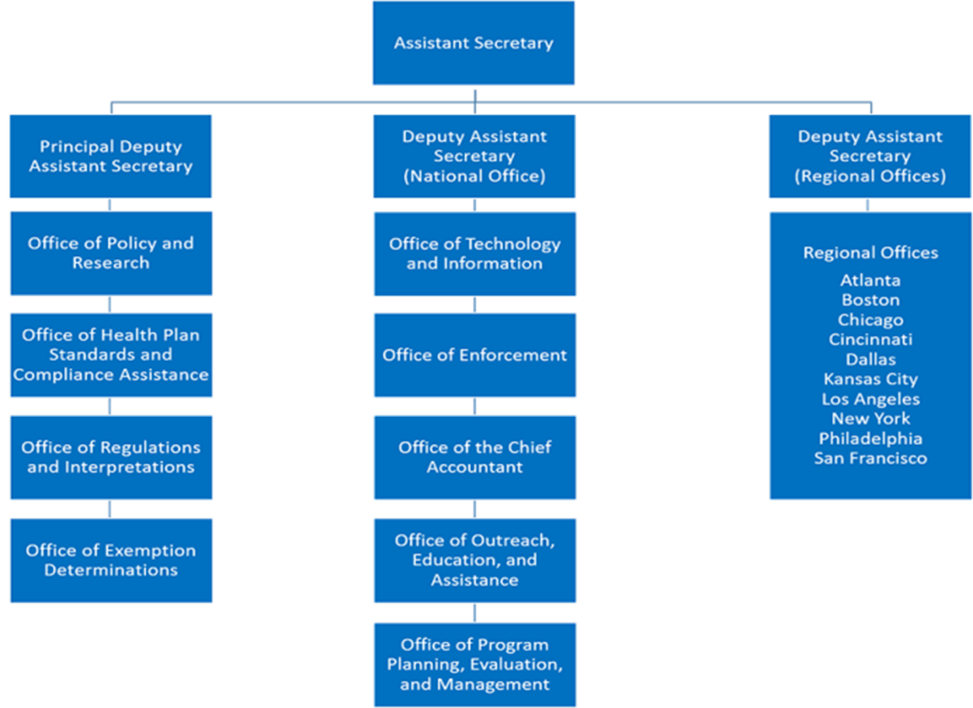
EBSA’s organizational structure

Slide 6
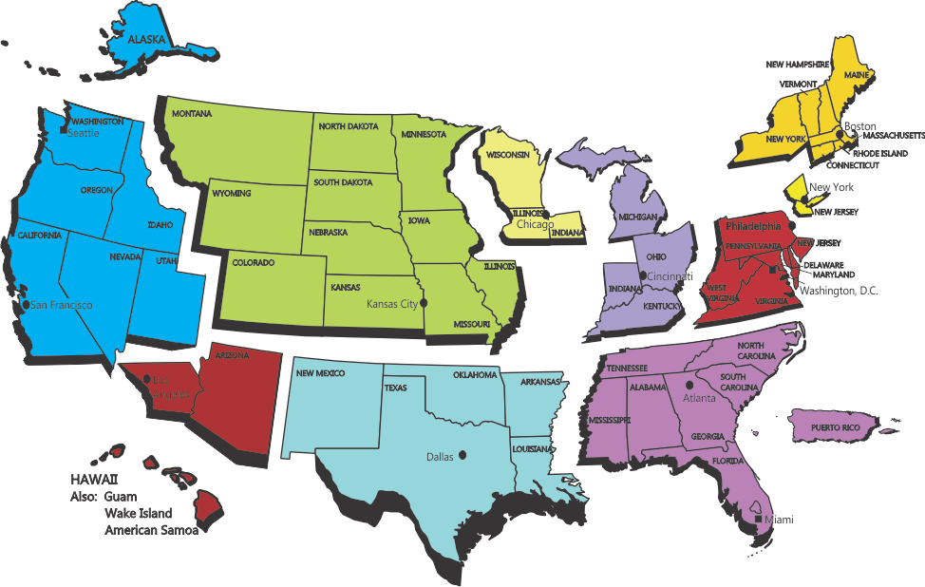
EBSA’s field offices

Slide 7
EBSA’s field offices
Benefits Advisors
Investigators
PROVIDE PARTICIPANT AND COMPLIANCE ASSISTANCE
CONDUCT
INVESTIGATIONS

Slide 8
Sources of cases
Participant complaints
Form 5500 Reviews
Referrals from other agencies
Media
Other

Slide 9
Types of investigations
Civil
Plan
Service Provider
Criminal
Plan
Service Provider
Employer
Individual

Slide 10
Areas of review in civil cases
Review of Plan Assets
Prudence, Prohibited Transactions, Self Dealing
Selecting and Monitoring of Service Providers
Reporting to the Government
General Plan Operations
Recordkeeping
Remittance of Employee Contributions
Locating Missing Participants
Disclosure to Plan Participants and Beneficiaries

Slide 11
fiduciary duties

Slide 12
What is a fiduciary?
In general – position of trust, acting for the benefit of others with a high duty of care and loyalty
ERISA – any person who exercises discretionary authority or control over plan assets or administration, or gives investment advice for a fee

Slide 13
WHO is a fiduciary?
Plan administrator
Trustee
Plan sponsor
Investment manager
Plan attorney or accountant
Insurance company

Slide 14
Fiduciary must…
Act “solely in interest” of participants and beneficiaries
Discharge his / her / its duties prudently (care, skill, prudence and diligence)
Diversify plan investments
Follow terms of governing document (to the extent consistent with ERISA)

Slide 15
Fiduciary must NOT…
act in his/her/its own self interest
act on behalf of a party with adverse interests
accept “gratuity” from those doing business w/ the Plan (kickback)

Slide 16
Fiduciary must NOT…
Fiduciaries must NOT cause the Plan to engage in a “prohibited transaction”
Sale/exchange with a party in interest
Loan/extension of credit with a party in interest
Goods, services & facilities with a party in interest
Transfer to, use by or for the benefit of a party in interest

Slide 17
Careful selection of service providers
When you need help, get help – remember the prudent expert rule
A fiduciary’s success may depend on how well the fiduciary selects the plan’s service providers
The selection of service providers is a fiduciary act – prudence is a process

Slide 18
Tips for selecting service providers
Consider what services you need
Obtain information from more than one service provider (services, experience with employee benefit plans, costs)
For valid comparison, make sure each provider has same information
Consider “bundled” and “unbundled” services
If a license is required (attorney, accountant, etc.), check with state or federal licensing authorities to confirm provider has up-to-date license

Slide 19
Tips for selecting service providers
Obtain commitment from provider for regular updates on services
Document the process you followed in reviewing and selecting service providers
When renewing contracts with service providers – repeat the selection process / confirm that facts on which initial selection was made have not changed
Make sure you understand terms of agreements or contracts

Slide 20
Monitor plan service providers
Plan fiduciaries must prudently select plan service providers and periodically monitor them to make sure the services are being delivered as agreed.
Remember - the plan fiduciary may be liable if the service provider fails to carry out its responsibilities.

Slide 21
Reporting
Form 5500/form 5500-sf

Slide 22
Reporting to the government
The Form 5500/Form 5500-SF Annual Return/Report
One Form satisfies DOL, IRS, PBGC
Financial condition and general operation of the plan for the prior year
Required information depends on type of plan and number of employees covered

Slide 23
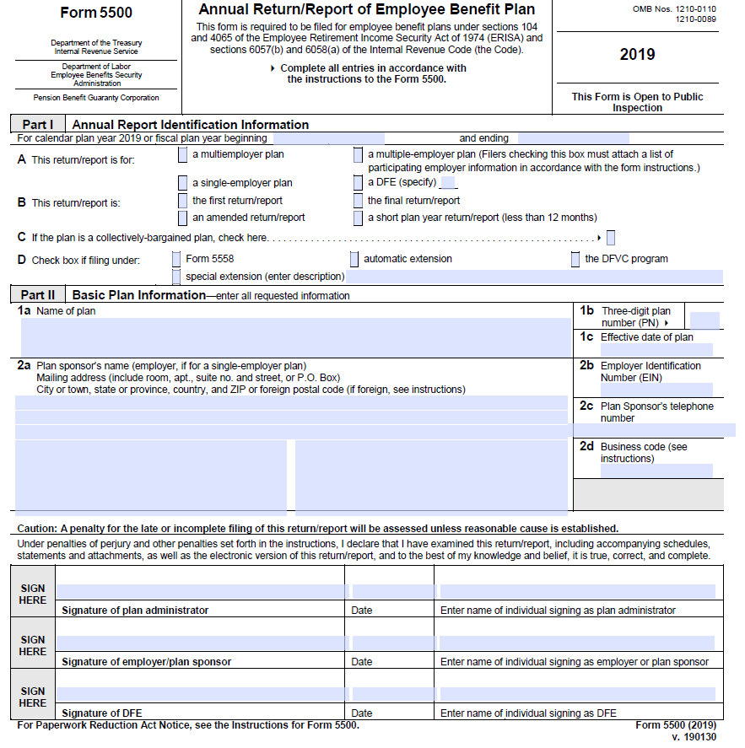
Reporting to the government

Slide 24
The form 5500/form 5500-sf – who?
Most pension plans (e.g., 401(k), defined benefit, profit sharing, 403(b) covered by Title I of ERISA)
Special rules for small plans (<100 participants)
Exemptions for SEPs and SIMPLE-IRAs
No blanket exception for small pension plans

Slide 25
The form 5500/form 5500-sf – when?
When is Form 5500 or Form 5500-SF due?
Last day of seventh month after end of plan year
Example: If your plan year ends on December 31, 2019, the plan’s Form 5500 must be filed no later than July 31, 2020
Extension available
Maximum 2 ½ months

Slide 26
The form 5500/form 5500-sf – what?
Plan identification information
Financial statement information
Insurance policy information
Actuarial information (DB Plans)
Service provider information
Plan investment transaction schedules
Retirement plan information

Slide 27
The form 5500 – accounts report
Large plans (100 or more participants) generally must be audited each year
Small plans (fewer than 100 participants) usually can satisfy conditions in DOL regulation for audit waiver
Selecting a qualified auditor – see publication for tips

Slide 28
FORM 5500-sf (short form)
“Short Form” 5500 for Small plans (under 100 participants). Can use if:
Exempt from annual audit requirement;
100% invested in secure investments that have a readily determinable fair value;
Hold no employer securities; and
Not multiemployer plan.
No Schedules required except DB plans required to file actuarial schedule.

Slide 29
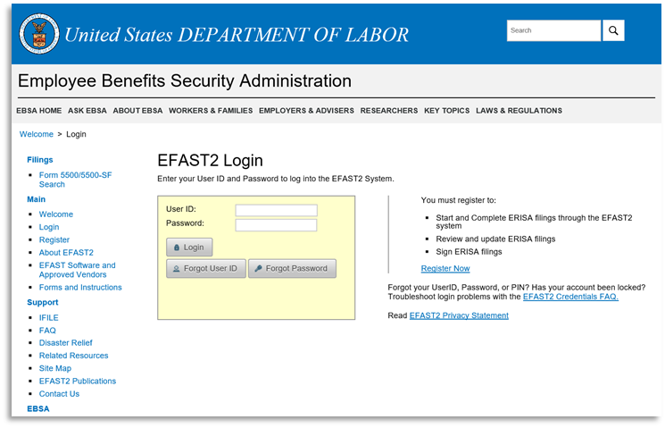
the form 5500/form 5500-sf – how?
Form 5500/Form 5500-SF must be filed electronically using EFAST2 system
Third-party software
No-Frills IFILE
Applies to all filings, including amended and delinquent filings for 2009 and earlier

Slide 30
FORM 5500/form 5500-sf – common mistakes
Failure to file timely report
Failure to include accountant’s audit report where required
Failure to monitor service providers (accountant, insurance company, benefits consultant)

Slide 31
FORM 5500/form 5500 sf
Preventing and Correcting Mistakes
Prevent filing mistakes by validating and correcting before submitting your filing.
Check your status report after you file and fix any errors that you find.
You can file an amended Form 5500/Form 5500-SF at anytime to correct a mistake you discover.
If DOL discovers a mistake, you will be sent a notice
Read the notice carefully and respond timely
Personal liability for penalties – plan CANNOT pay

Slide 32
FORM 5500 – late filings
If you fail to file or file a late Form 5500, check out the Delinquent Filer Voluntary Compliance Program
Reduced late filing penalties
IRS, PBGC also may grant relief to DFVCP users
Too late for DFVCP if notified of failure by DOL
Call 202-693-8360 with DFVCP Questions

Slide 33
FORM 5500 – getting help
Reporting and Disclosure Guide
Troubleshooter’s Guide to Filing the ERISA Annual Report (Form 5500 and Form 5500-SF)
ERISA Filing Acceptance System 2 (EFAST2) website at www.efast.dol.gov
EFAST2 Help Line at 1-866-463-3278 (toll free number)

Slide 34
General plan administration
Recordkeeping
Making timely contributions
Missing participants
DISCLOSURE TO PARTICIPANTS AND BENEFICIARIES

Slide 35
Recordkeeping – plan records
Plan records include:
Manually signed copy of Form 5500/Form 5500-SF
Info used to prepare Form 5500/Form 5500-SF
Contribution records and benefit payments
Other financial records of the plan
Participant and beneficiary information

Slide 36
Recordkeeping
Must maintain plan records used to prepare Form 5500/Form 5500-SF for at least 6 years
Includes records needed to verify, explain, clarify Form 5500/Form 5500-SF:
vouchers, worksheets, receipts
payroll records and reports
contribution records and reports
claims records
auditor reports and accountant opinions

Slide 37
Recordkeeping
Must retain some records for more than 6 years
Records necessary to determine benefits payable under the plan include:
plan eligibility records
individual work and compensation history
contribution records
beneficiary information

Slide 38
Recordkeeping
If you hire a third party to maintain your records – remember:
Make clear in your contract which records belong to the plan and when and how records must be maintained and made available.
Duty to maintain records cannot be avoided by contract, delegation, or otherwise – in other words – you are still on the hook.
Monitor the work of your recordkeeper.

Slide 39
Making timely contributions
Contributions Overview
Employer contributions – contribute per plan documents – failure may result in legal action by plan fiduciary
Participant contributions – become “plan assets” when reasonably segregable from employer’s general assets – failure may result in violation of trust requirements and prohibited transactions.

Slide 40
Participant contributions – the rule
Amounts withheld from employees’ wages must be transmitted to plan as soon as they reasonably can be segregated from the company’s general assets.
A small plan (with fewer than 100 participants) will be deemed to be in compliance if participant contributions are received by the plan within 7 business days. (This is an optional safe harbor for small plans.)

Slide 41
Participant contributions – TIP
Delinquent participant contributions can be one of the biggest problems for sponsors of 401(k) plans.
Review your payroll system and work with service providers to ensure that participant contributions are forwarded to the plan on the earliest possible date in compliance with the law.
“As soon as” varies from plan to plan
will ask questions about handling
will review practice/experience

Slide 42
Missing participants – fab 2014-01
Locating Missing Participants of Terminated Defined Contribution Plans
Plan fiduciary must always:
Use Certified Mail
Check Related Plan and Employer Records
Check with Designated Plan Beneficiary
Use Free Electronic Search Tools

Slide 43
Missing participants – making distributions
Consider:
Using PBGC’s Missing Participants DC Plan Program
Rollover to Individual Retirement Plan
Safe Harbor for Distributions from Terminated Individual Account Plans – 29 CFR 2550.404a-3.
Other Options:
Interest-bearing, federally insured bank account
State unclaimed property fund
100% income tax withholding is not an acceptable distribution option

Slide 44
Disclosures to Participants and Beneficiaries
Summary Plan Description (SPD) and Summary of Material Changes (SMM)
Summary Annual Report (SAR)
Pension Benefit Statements
Black Out Notices
Annual Funding Notices (AFN)
Fee & Investment Disclosures

Slide 45
What is an spd?
SPD is basic ERISA disclosure document
Must accurately summarize plan, including benefits, rights, and obligations under the plan
Must be written to be understood by average plan participant

Slide 46
Who gets an SPD and when?
Must furnish automatically to participants within 90 days of being covered by plan and to pension beneficiaries within 90 days of receiving benefits
Must furnish current SPD on request to participant or pension beneficiary receiving benefits
Generally, must redistribute every 5 years

Slide 47
Spd – what if plan changes?
What kind of pension changes must be disclosed?
Material plan changes and changes in information in SPD
How must changes be disclosed?
Must furnish all participants and pension beneficiaries receiving benefits with an SMM no later than 210 days after end of plan year
OK to furnish new SPD with changes

Slide 48
Summary annual report (sar)
What is it?
Summary of Form 5500/Form 5500-SF information
Fill in the blank format prescribed with cross-reference to Form
When must it be furnished?
Within 9 months after close of plan year (or if later, no later than 2 months after Form 5500/Form 5500-SF due)
Must furnish automatically to participants and pension beneficiaries receiving benefits
Not applicable to DB plans providing annual funding notice

Slide 49
Pension benefit statements
Provided automatically to participants.
Quarterly statements – participant- directed DC plans
Annual statements – DC plans
Triennial statements – DB plans

Slide 50
Notice of blackout periods
Notice for individual account plans (e.g. 401(k))
Blackout Period = period of more than 3 consecutive business days where plan restricts participant’s ability to change investments, get loans or pension benefit distributions
Content and timing requirements apply
General rule: minimum 30 day advance notice (max. 60 days) to all affected participants and beneficiaries

Slide 51
Annual funding notice (afn)
Defined benefit plan notice
Content and timing requirements apply
Plans generally must furnish funding notices no later than 120 days after the close of each plan year
Notice must include, among other things, the plan’s funding percentage

Slide 52
Fee and investment disclosures
Disclosure Requirements
Participant-Directed Plans Only
Field Assistance Bulletin 2012-02R

Slide 53
Fee and investment disclosures
What information must be disclosed?
“Plan-related information”
General plan information
Administrative expense information
Individual expense information

Slide 54
Fee and investment disclosures – what information must be disclosed?
“Plan-related information”
General plan information
Administrative expense information
Individual expense information
“Investment-related information”
Performance data
Benchmark returns
Fee and expenses
Internet website address
Glossary

Slide 55
Fee and investment disclosures – when and how much?
When must the information be disclosed?
Up front
Annually (2-month grace period available)
Additional Information on request
How must the information be disclosed?
Comparative chart
Model provided

Slide 56
Fee and investment disclosures
Any other information?
“statement of expenses actually deducted”
Plan-related expenses
Administrative expenses
Individual expenses
At least quarterly
May be included in the individual benefit statement

Slide 57
Disclosure upon request
Upon receipt of written request, must provide:
Form 5500/Form 5500-SF
Current SPD
Other instruments under which the plan is established or operated (e.g., plan trust agreement)
Miscellaneous disclosures

Slide 58
How to furnish documents
In hand delivery at workplace
By mail
Electronic delivery
(certain standards apply)
Posting by itself is not sufficient

Slide 59
Civil penalties may be assessed for failure to provide:
Plan documents and other instruments under which plan is operated requested by participant (includes current SPD and copies of Form 5500/Form 5500-SF)
Annual funding notices
Pension benefit statements
Automatic contribution notices
Blackout notices
Diversification rights notices

Slide 60
Voluntary fiduciary correction program

Slide 61
Voluntary fiduciary correction program
Allows “Plan Officials” to correct certain violations before DOL investigates and if done properly, receive a “No-Action” letter from the Department.
Covers 19 specific transactions and describes acceptable methods on how to correct them.
Eligibility is conditioned upon not being “under investigation” and upon the application not containing any evidence of criminal violations.
Correction must be made prior to submitting an application to the VFCP Coordinator in the EBSA Regional Office.

Slide 62
Voluntary fiduciary correction program
The VFCP is designed to be used by a Plan Official without assistance from an EBSA Regional Office.
Online calculator and display of IRS rates and factors on EBSA website.
Model Application Form available on EBSA website.
Includes online compliance assistance tools and reduced documentation requirements.

Slide 63
Voluntary fiduciary correction program
Identify ERISA violations involving the plan and determine if they are covered by the VFCP.
Make sure the Plan Official is not under investigation.
Follow the VFCP for correcting specific violations (i.e., improper loans, purchases, sales, etc.)
Follow the VFCP to calculate and restore amounts due to the plan including any lost earnings or profits.
Complete, sign, and date the checklist.
File a complete application with your EBSA Regional Office.
Submit all documents to your EBSA Regional Office
DOL reviews application and if complete, issues a “No-Action” letter.

Slide 64
Helpful ebsa publications
Meeting Your Fiduciary Responsibilities
Understanding Retirement Plan Fees and Expenses
Selecting an Auditor for Your Employee Benefit Plan
Reporting and Disclosure Guide
Selecting & Monitoring Pension Consultants – Tips for Plan Fiduciaries
Tips for Selecting and Monitoring Service Providers for Your Employee Benefit Plan

Slide 65
Resources
Subscribe to the DOL, EBSA website for updates: https://www.dol.gov/agencies/ebsa
FAQs (Frequently Asked Questions)
https://www.dol.gov/agencies/ebsa/about-ebsa/our-activities/resource-center/faqs
Technical Releases
https://www.dol.gov/agencies/ebsa/employers-and-advisers/guidance/technical-releases
Questions
Web inquiries: https://www.dol.gov/agencies/ebsa/about-ebsa/ask-a-question/ask-ebsa
Phone inquiries: 866-444-EBSA (3272)

Slide 66
Questions?
Lois La Londe
Supervisory Benefits Advisor
United States Department of Labor
Employee Benefits Security Administration
33 Whitehall Street, Ste 1200
New York, NY 10004
(212) 607-8638
Lalonde.lois@dol.gov

